Slide 1
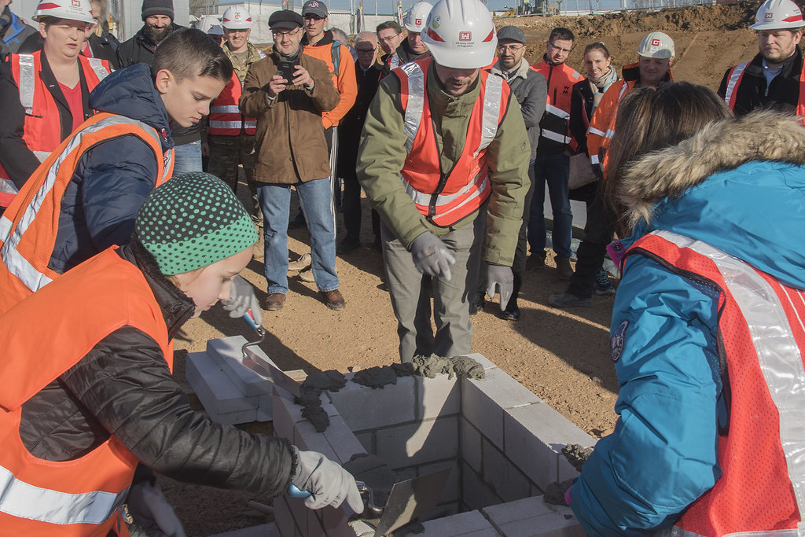
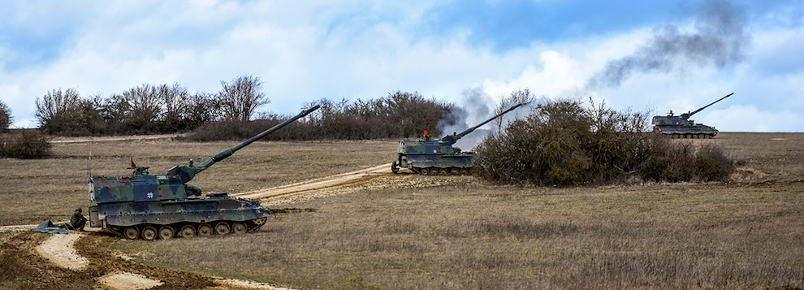
USACE OVERSEAS CONSTRUCTION
LTG Scott A. Spellmon
55th Chief of Engineers
Commanding General, USACE

Slide 2


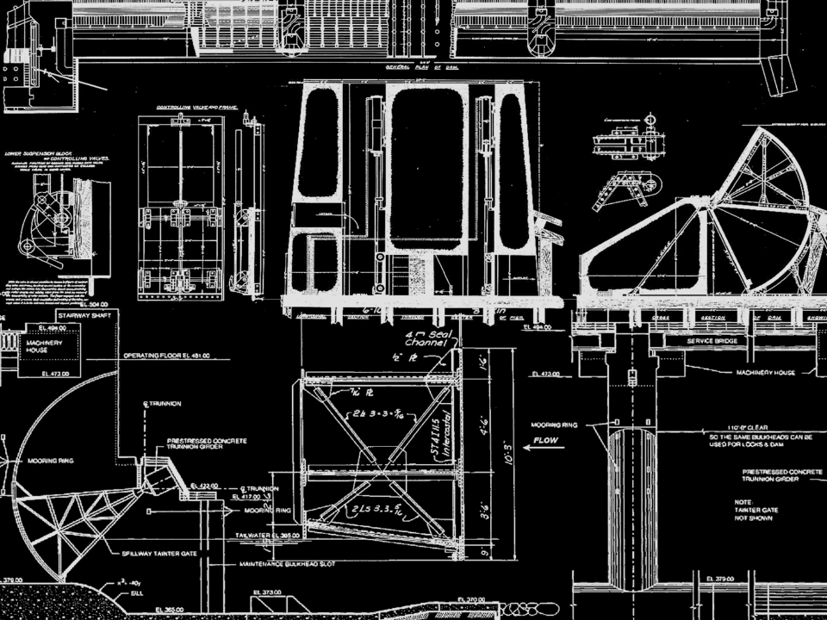
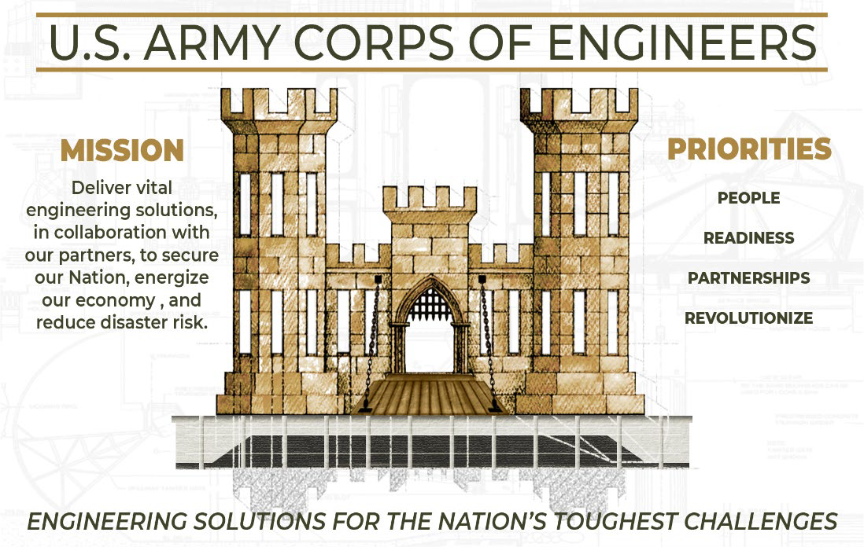
MISSION
Deliver vital engineering solutions, in collaboration with our partners, to secure our Nation, energize our economy, and reduce disaster risk.
VISION
Engineering solutions for the
Nation’s toughest challenges.
PRIORITIES
PEOPLE READINESS PARTNERSHIPS INNOVATE

Slide 3
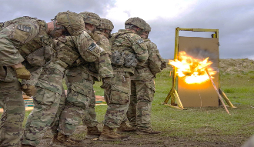
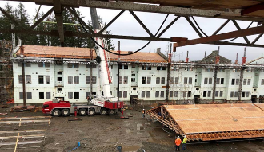
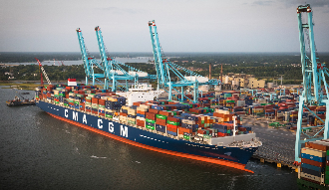
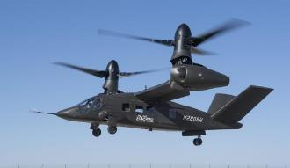
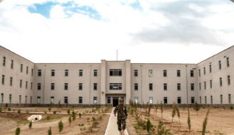
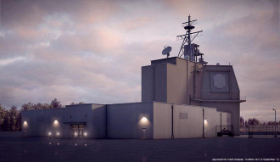
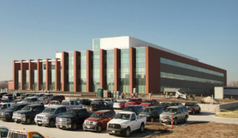

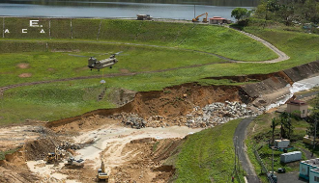
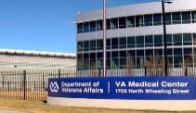
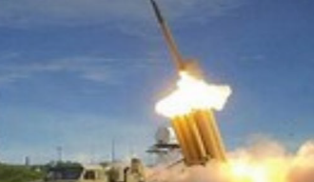
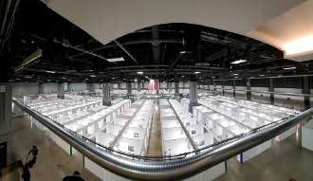
Our Current USACE Mission Set
DA
Delivering
an historic
$91B
portfolio
of
programs,
projects,
and
support
The Engineer Regiment
90,000 members of the
Total Engineer Force
DA MILCON and
Installation Readiness
$4.9B / 3M service members /
287 Installations
Civil Works
$8.343B / ~1,900 projects
$17.44B + $3.3B Disaster Supp / Relief ( HR 2157 )
$5.7B Emergency Assistance ( HR 5305 )
$17.1B Infrastructure Investment and Jobs Act ( IIJA ) ( HR 3684 )
Research and Development
$1.35B / 2,000+ projects
supporting DA, DoD, IIS
DoD
COCOM Support
$5B to COCOMS / Interagency
in 110 countries
Missile Defense Agency $875M to 5 critical projects
in Romania, Poland, and Alaska
USAF / USN / DHA / DLA
$10.7B installation infrastructure
for DoD and Sister Services
DOD / AF / DA / EPA / DOE
$2.0B in national
environmental cleanup
IIS
Natural Disaster Response
$4.5B response to disasters in
CA, TX, FL, PR, USVI, NC, LA
Veterans Affairs
$8.7B Design and
construct 22 Projects
Foreign Military Sales
$3.7B in design, construction, engineering services, and training in 35 countries
COVID-19 Response
$1.9B COVID Response ( 38 ACFs )
Support to Vaccine Production and
Mass Vaccination Centers

Slide 4
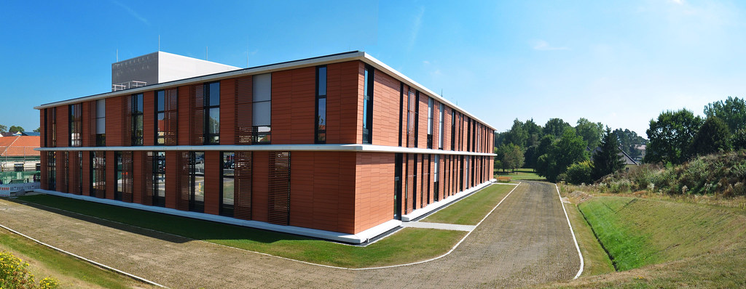
Vilseck Army Health Clinic
Vilseck, Germany

Slide 5
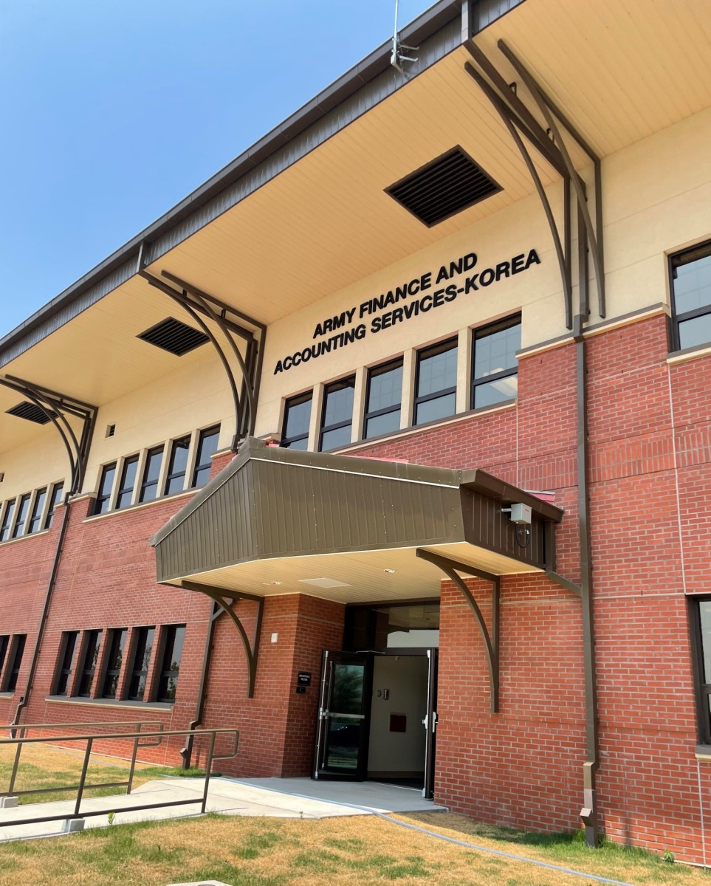
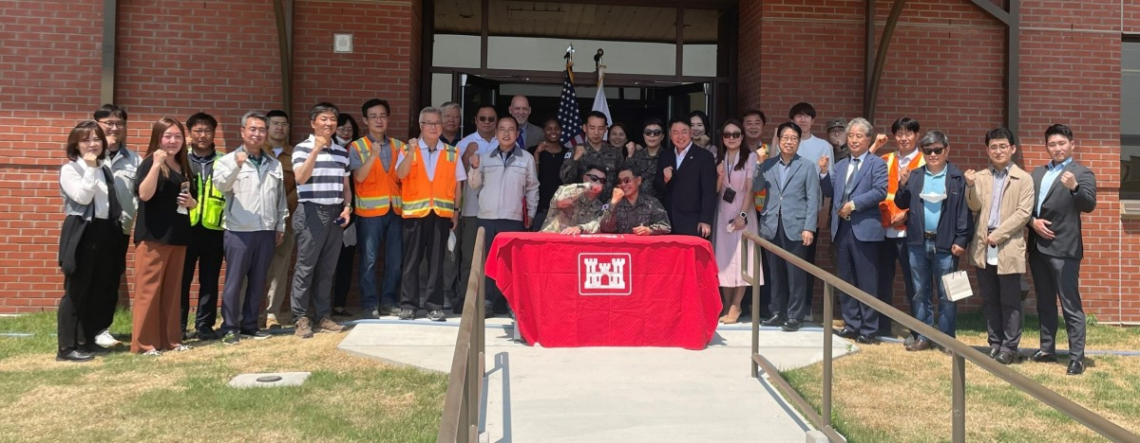
U.S. Army Finance & Accounting Services-Korea Building
U.S. Army Garrison Humphreys Pyeongtaek
Republic of Korea

Slide 6
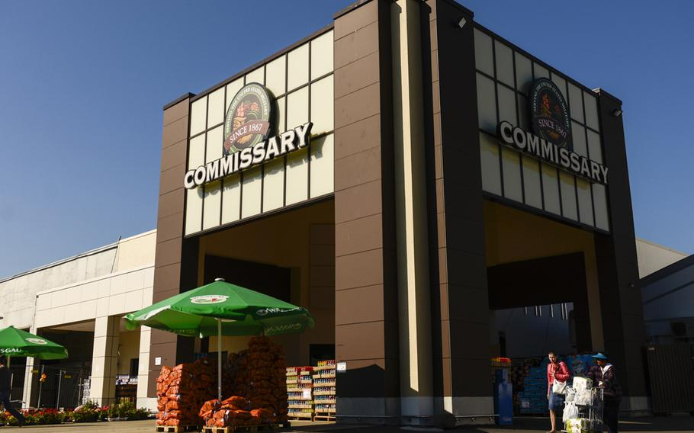
Ramstein Commissary
Ramstein Air Base
Germany

Slide 7
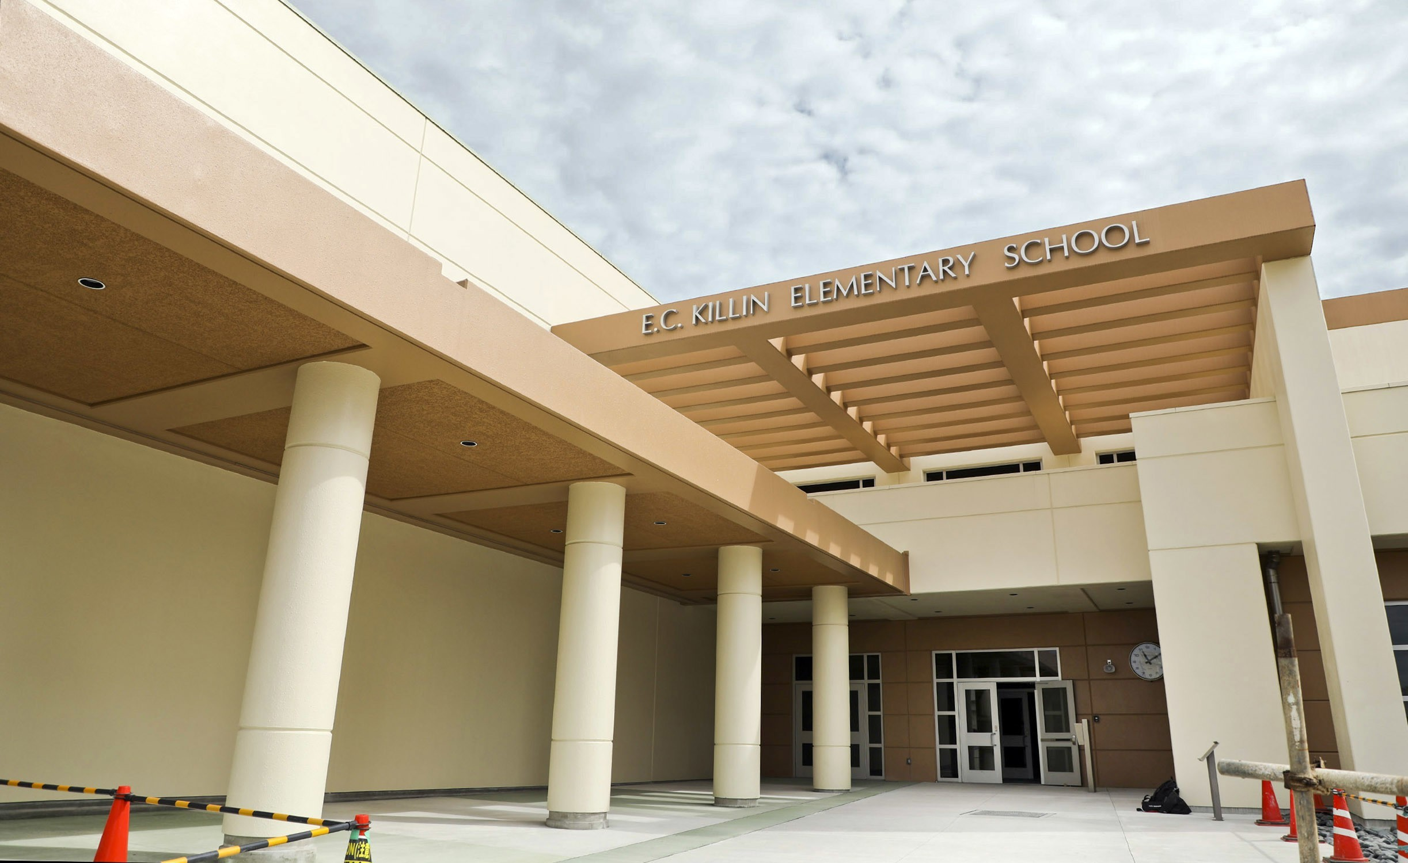
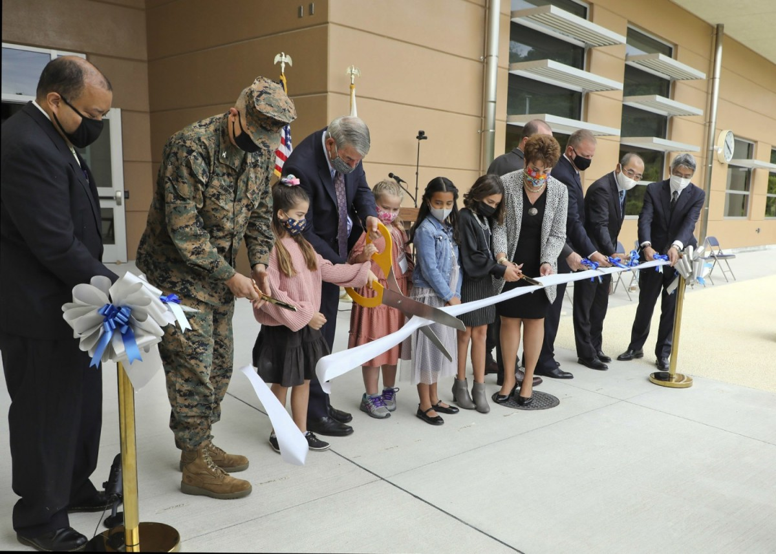
Department of Defense Education Activity
“21st Century Schools”
Edward C. Killin Elementary School
Okinawa, Japan

Slide 8
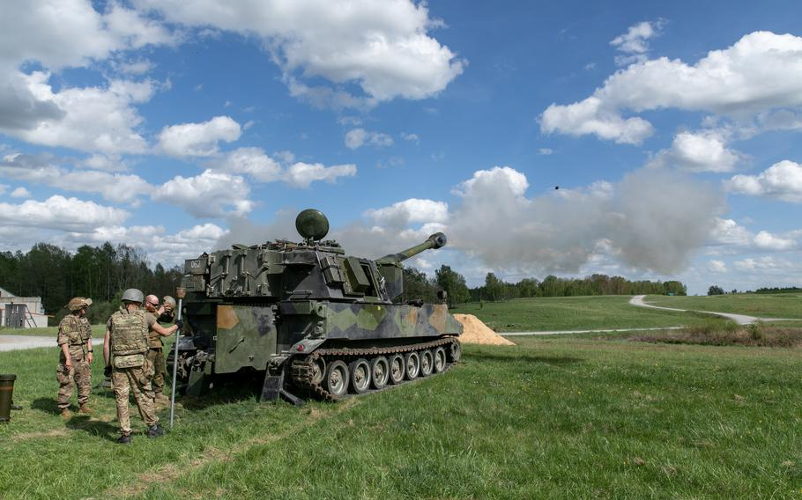
Grafenwoehr Training Ranges
Grafenwoehr
Germany
Credit: Stars and Stripes

Slide 9
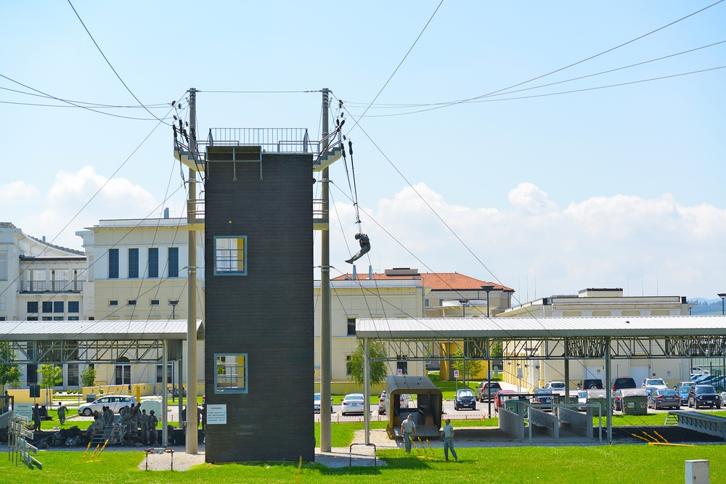
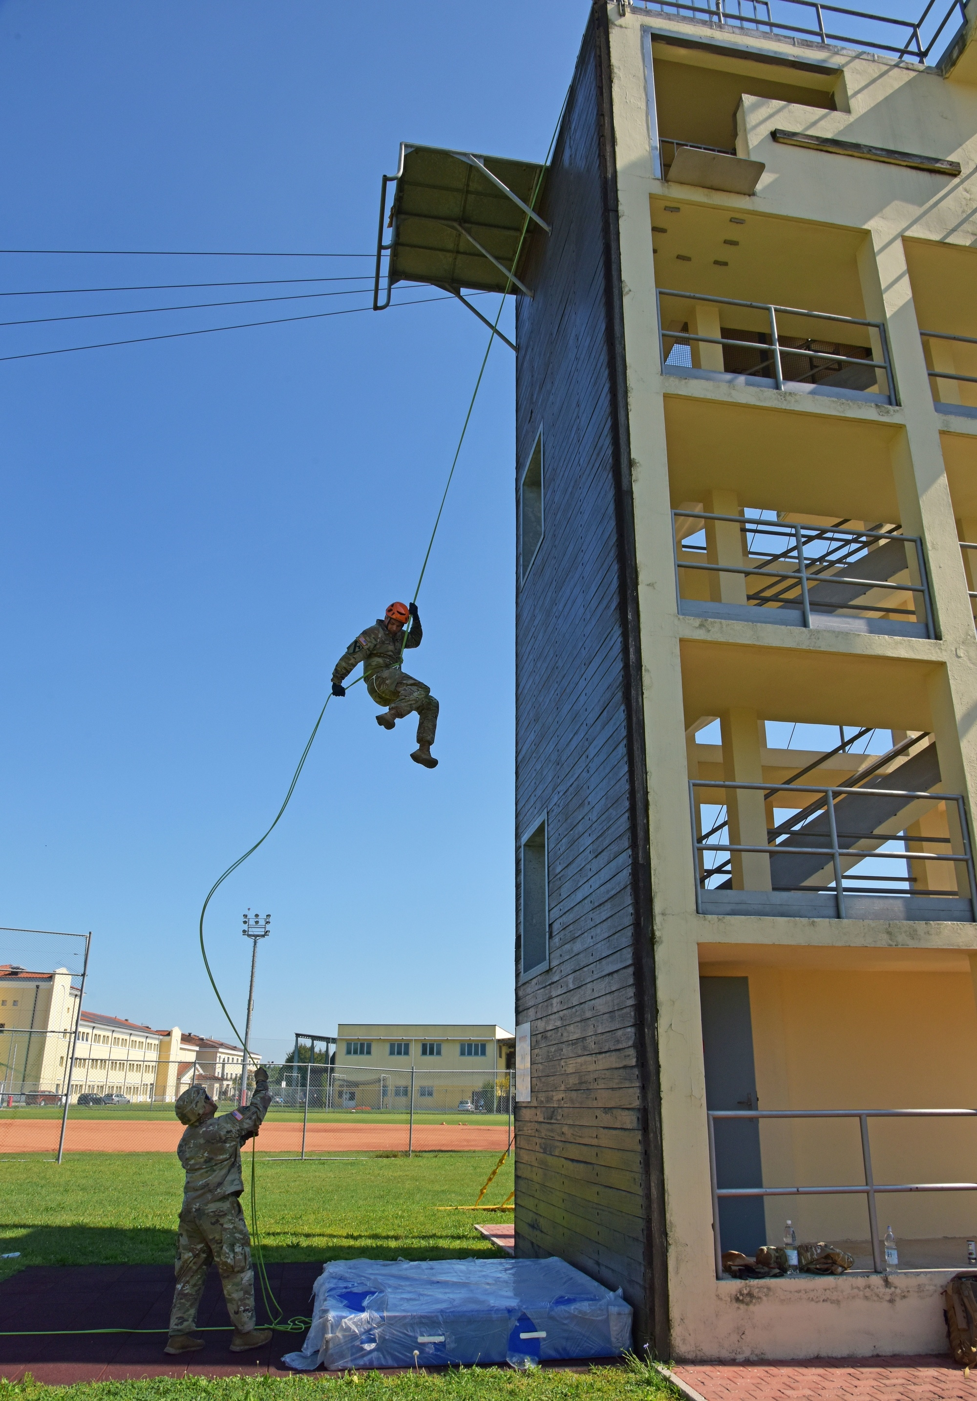
Rappel/Jump Training Tower
Caserma Ederle
Vicenza, Italy

Slide 10
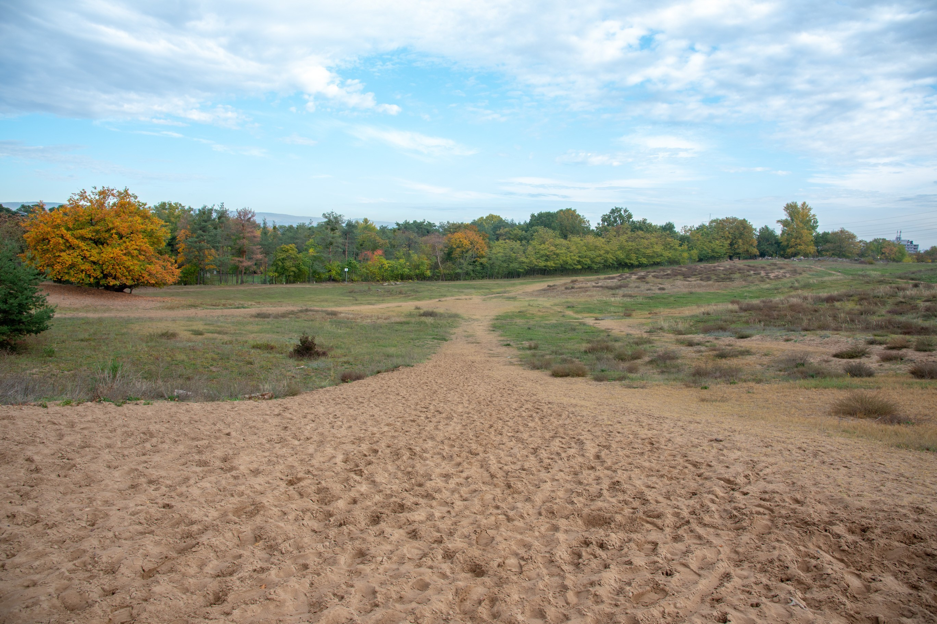
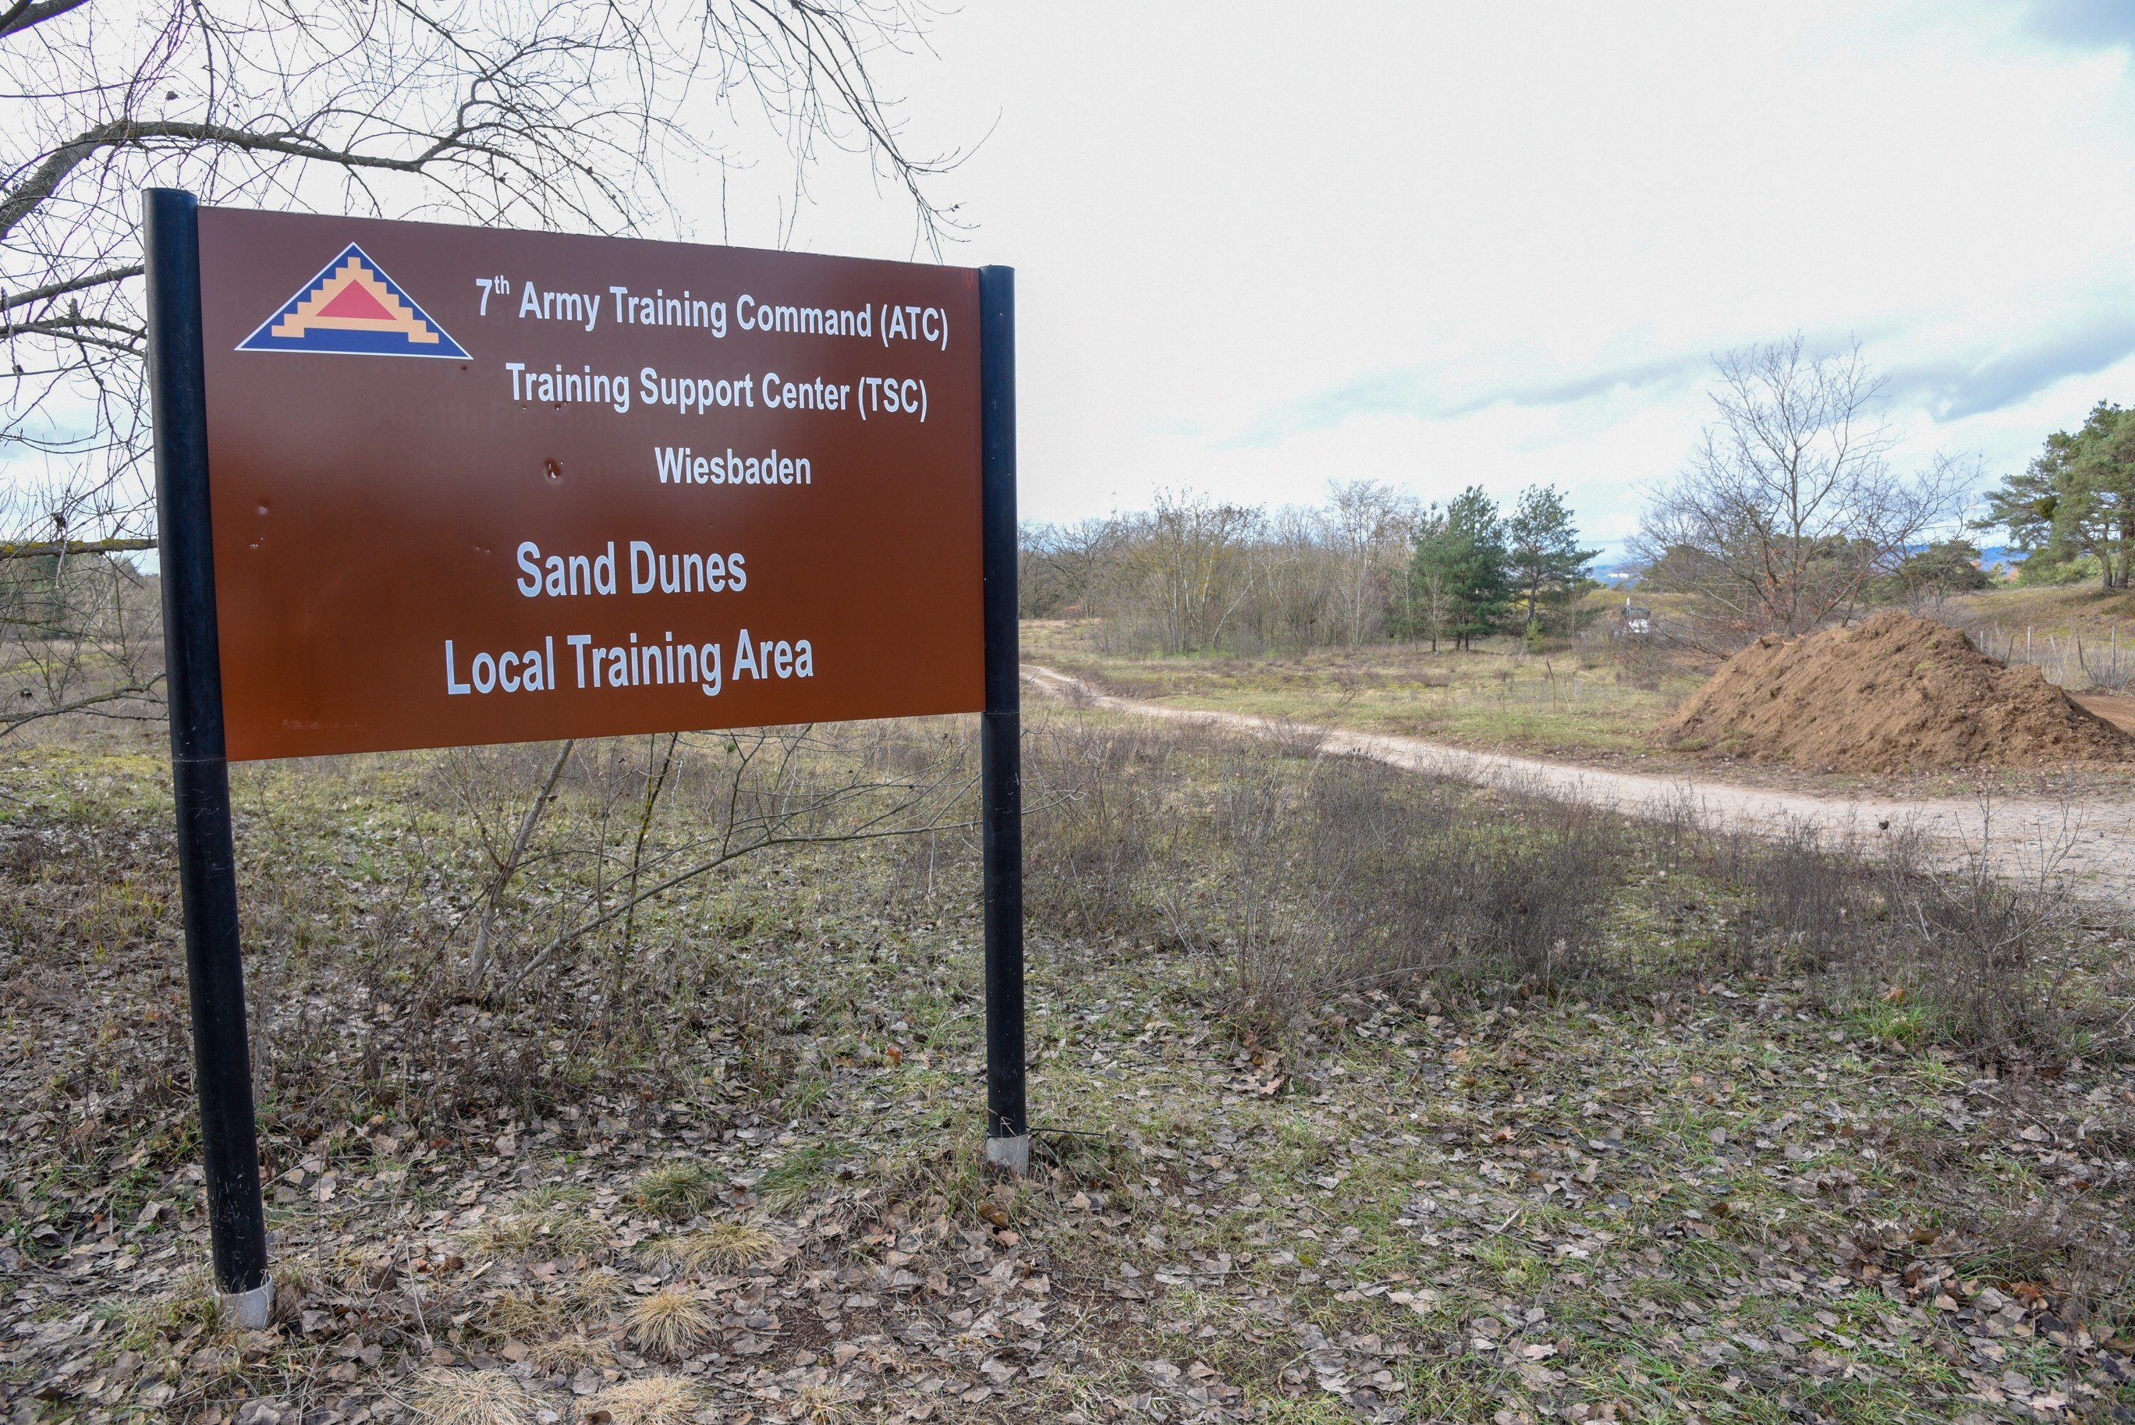
Mainz Sand Dunes Local Training Area
Mainz, Germany

Slide 11
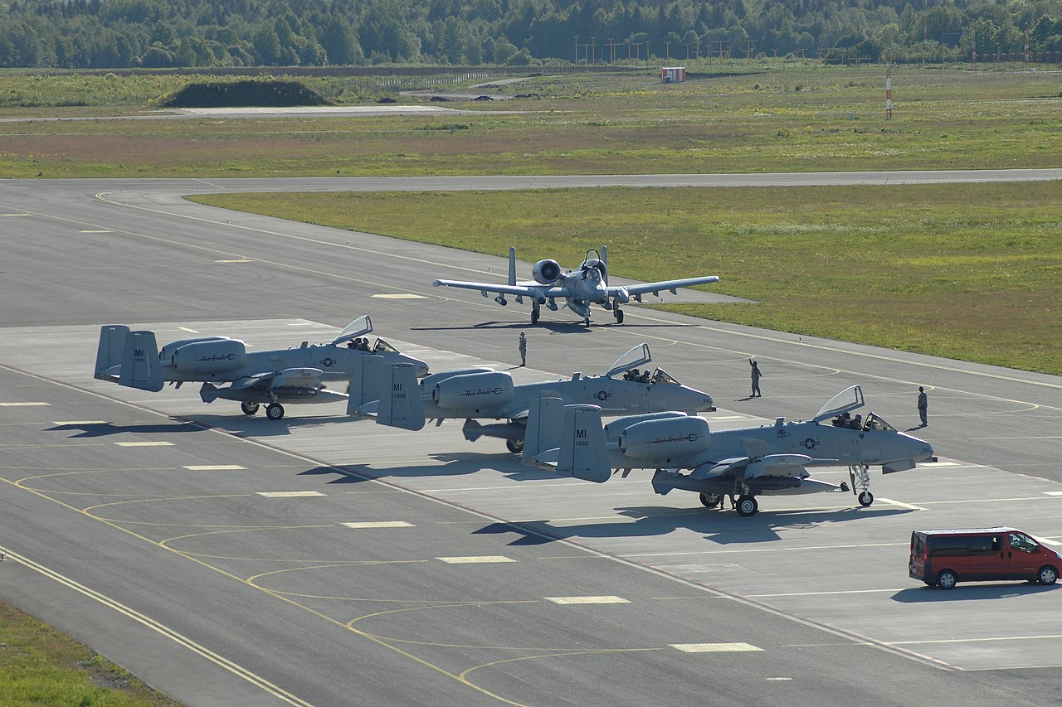
Ämari Air Base Construction
Ämari Air Base
Estonia

Slide 12
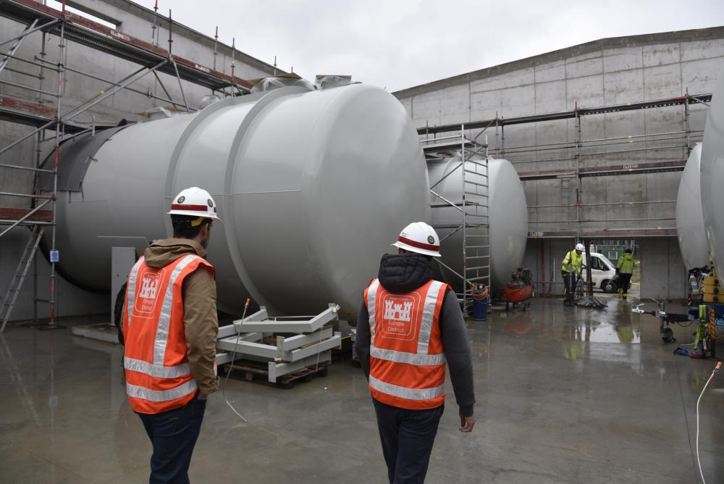
Bulk Fuel Storage
Ämari Air Base
Estonia

Slide 13
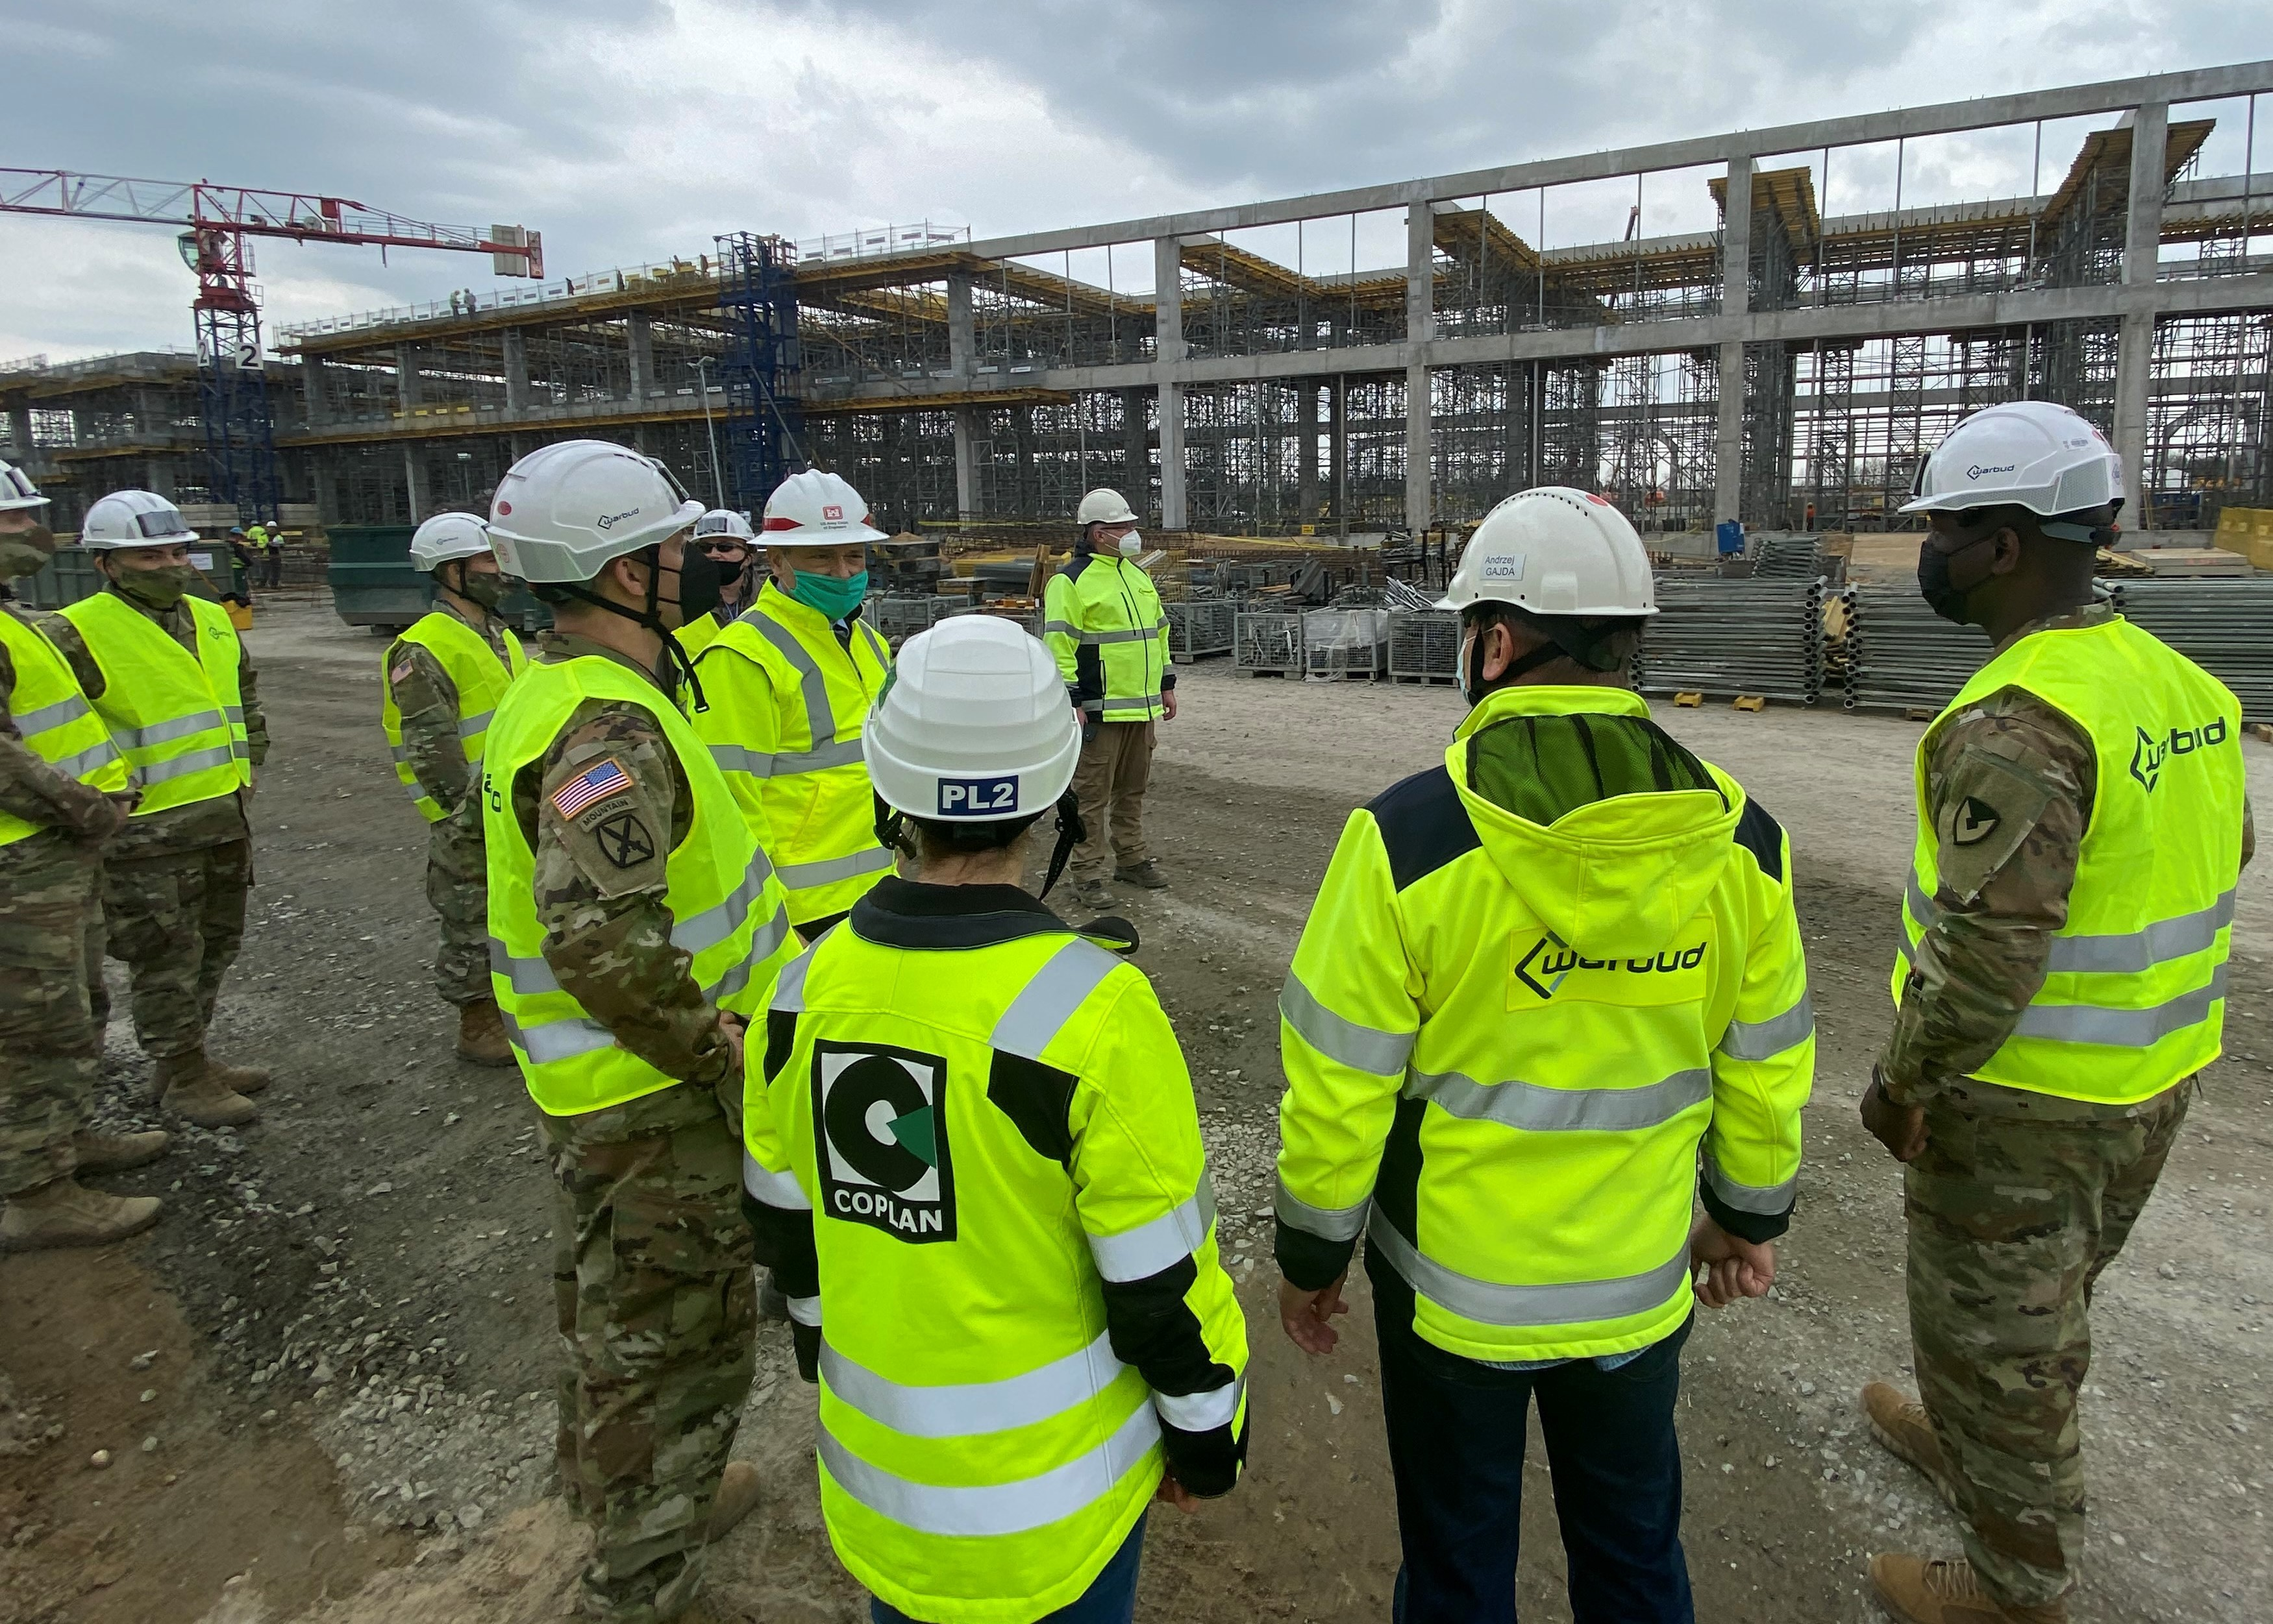
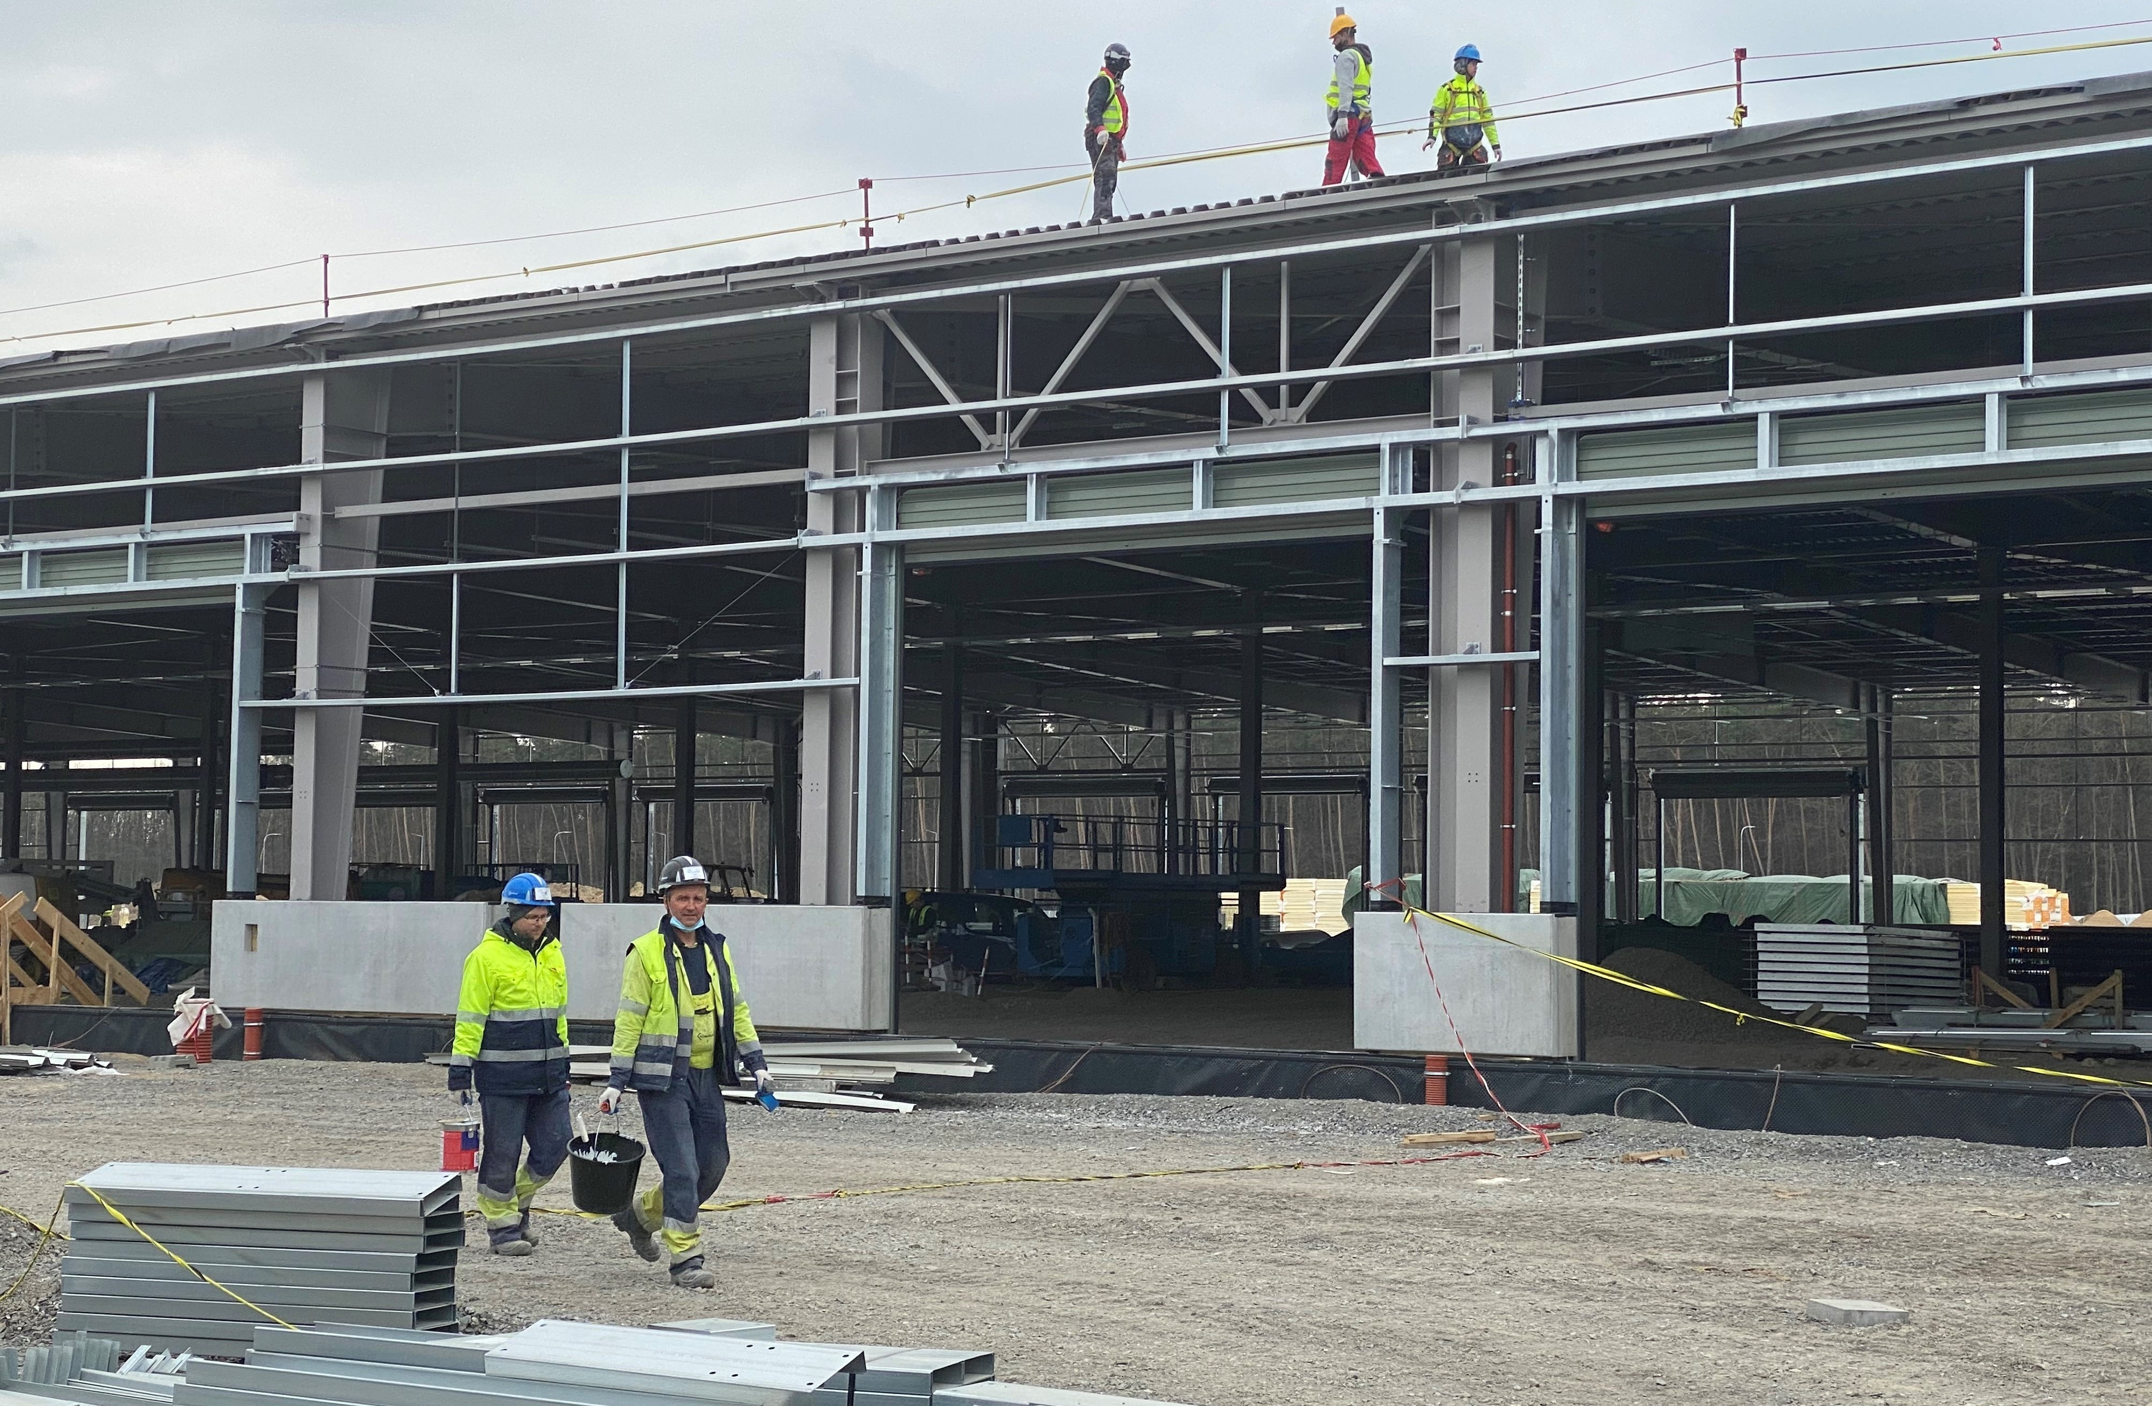
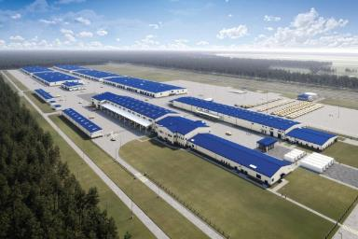
Army Prepositioned Stocks-2
Powidz, Poland

Slide 14
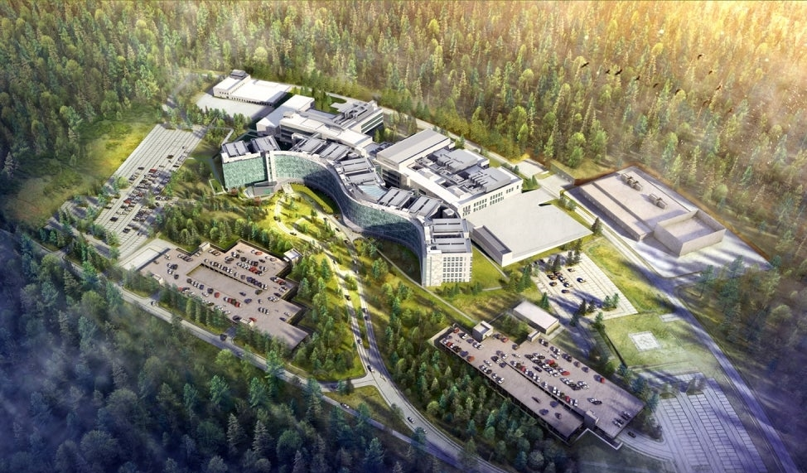
Rhine Ordnance Barracks Medical Center Replacement
Ramstein Air Base
Landstuhl, Germany

Slide 15
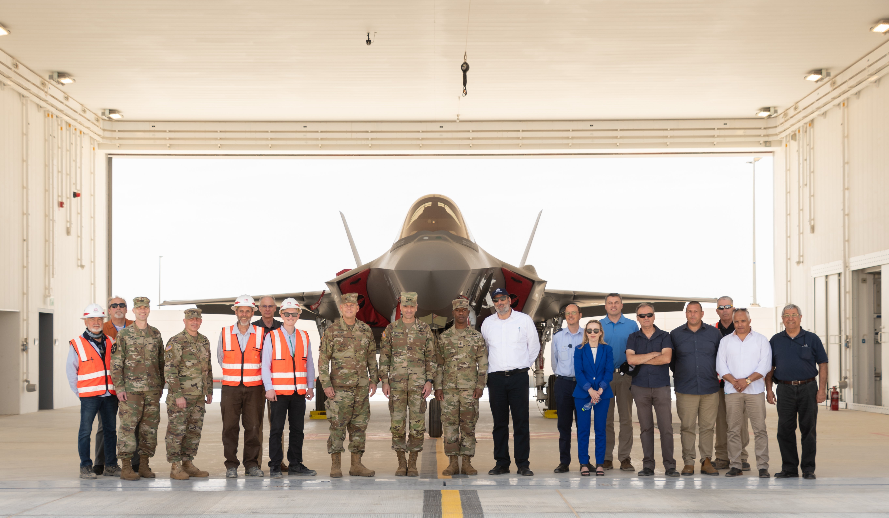
F-35 Aircraft Hangar
Israel

Slide 16
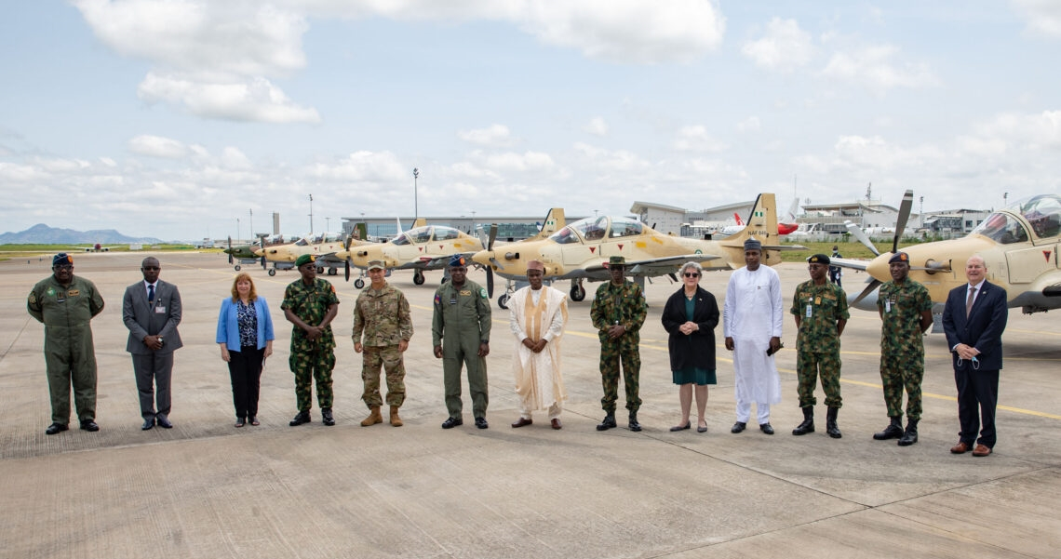
Kainji Air Force Base Construction
Nigeria
West Africa

Slide 17
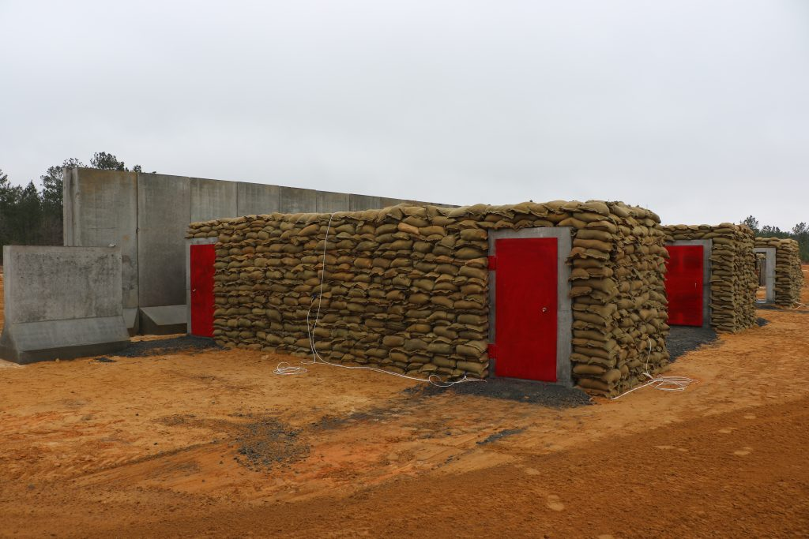
Innovative Bunker Technology
Transatlantic Division

Slide 18
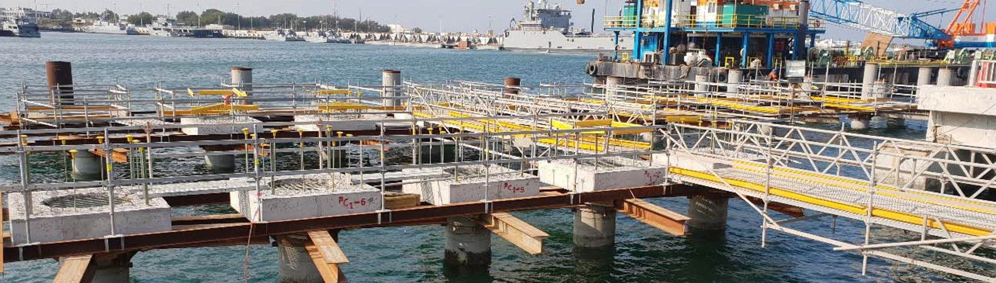
Breakwater and Cargo Pier Repairs
Kuwait Naval Base

Slide 19
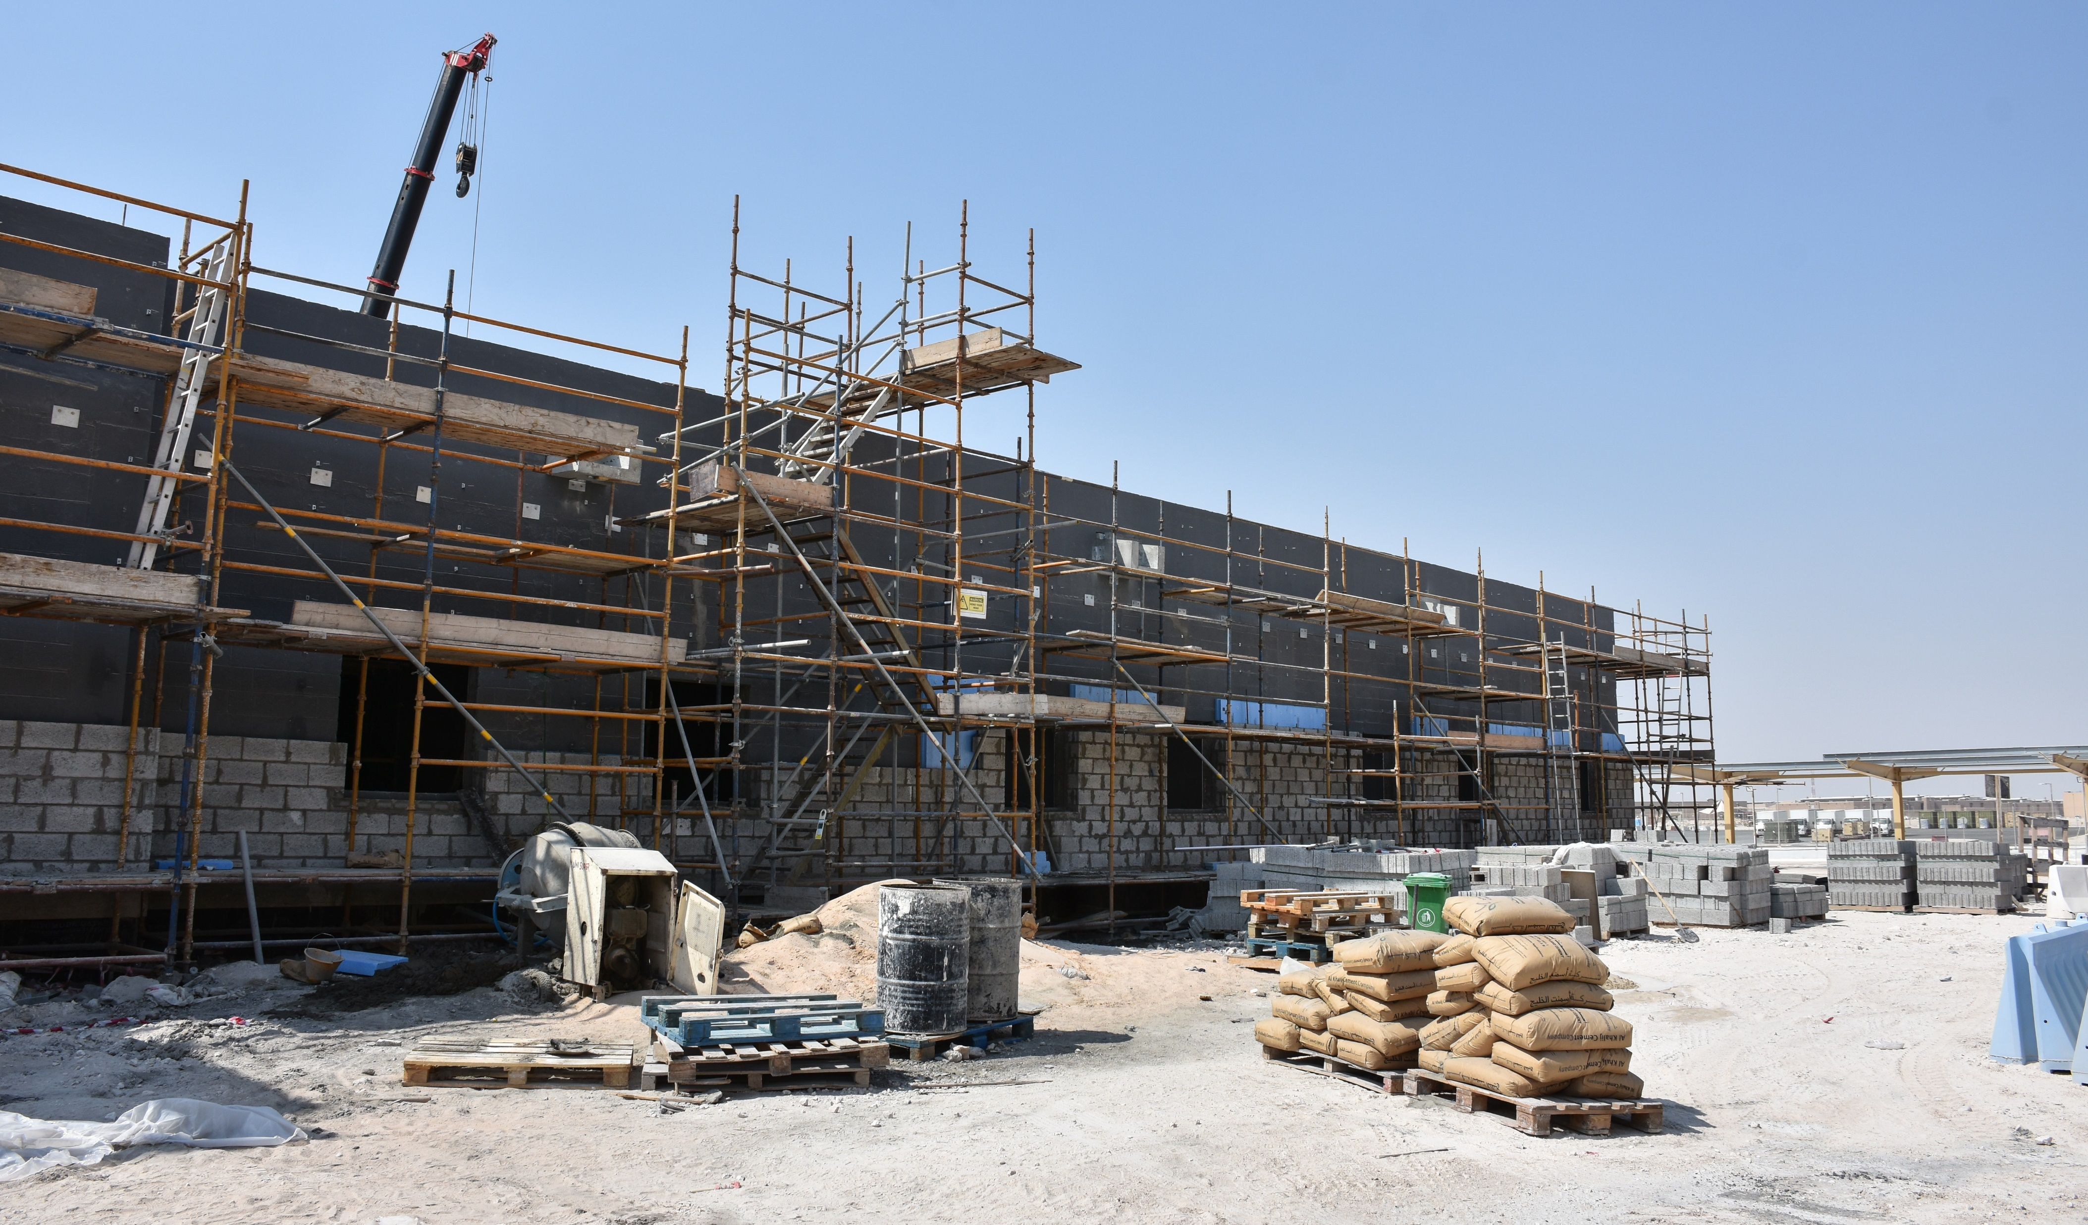
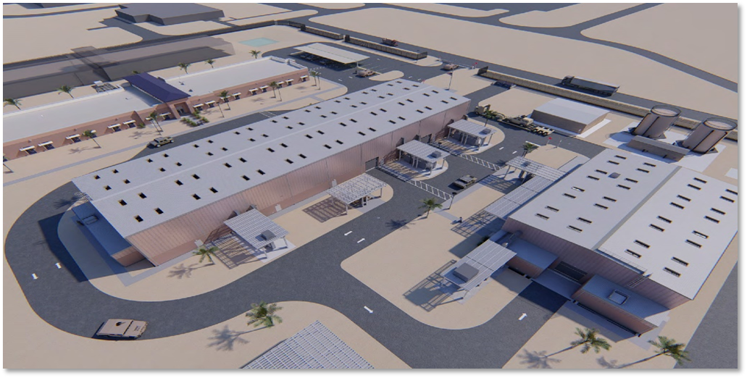
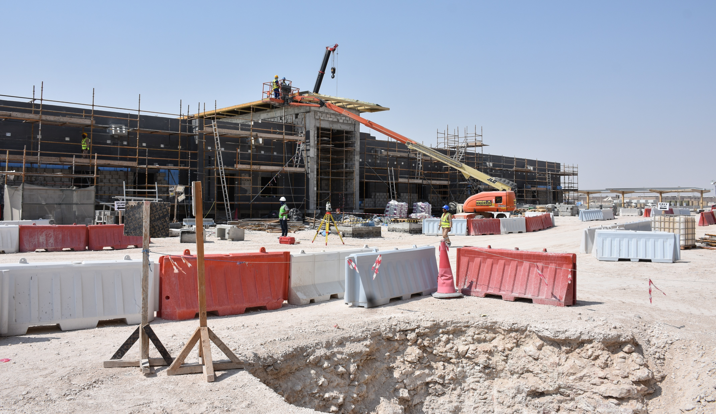
Transregional Logistics Center
Al Udeid, Air Force Base, Qatar

Slide 20
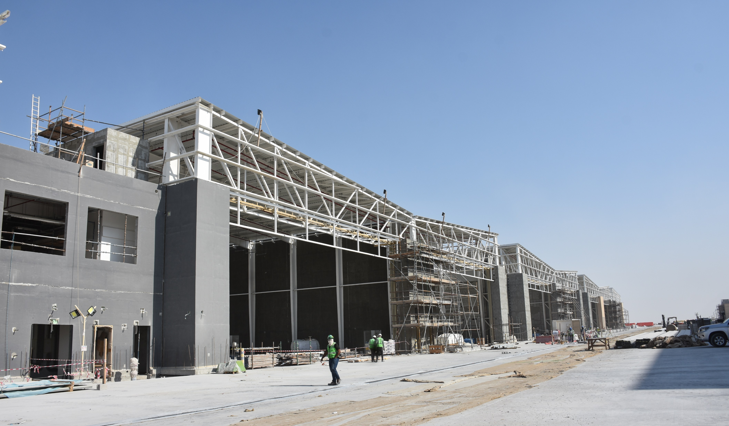
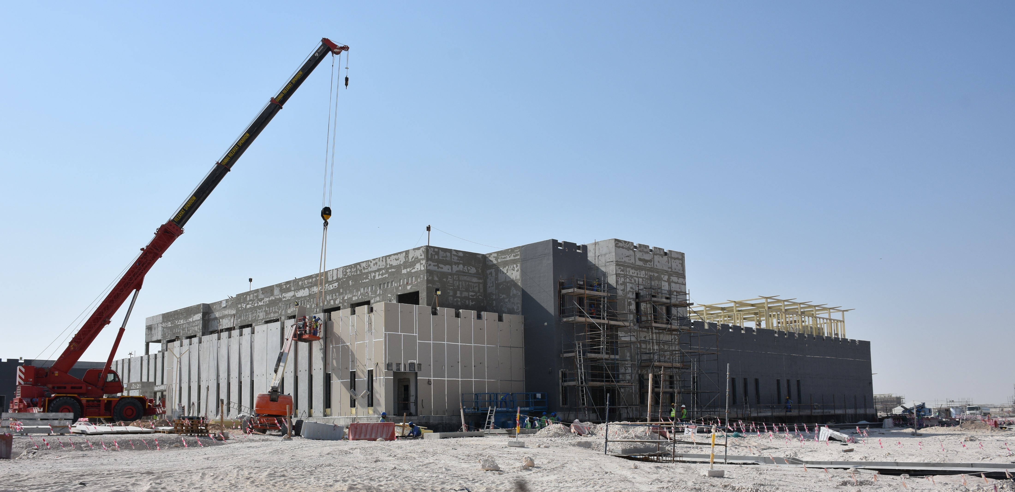
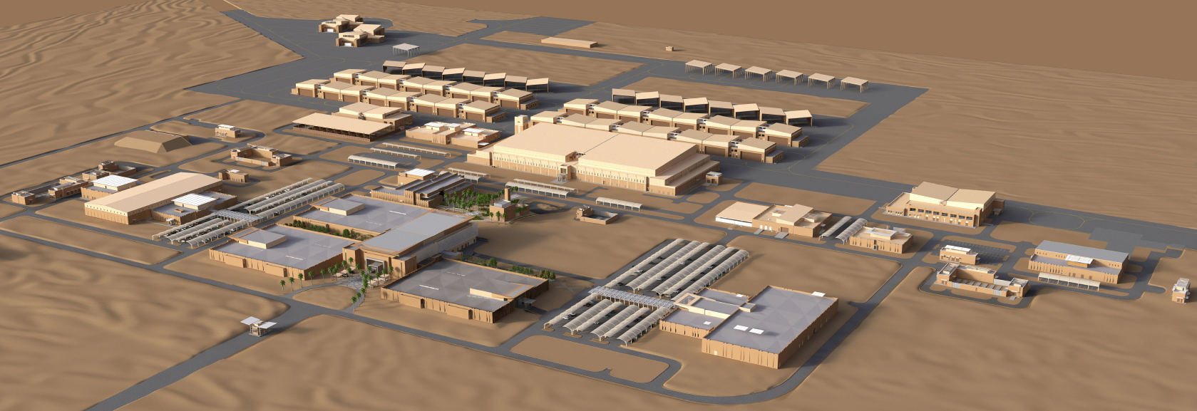
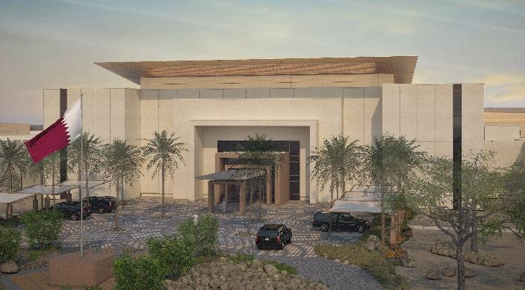
Falcon 5 F-15 Bed Down
Al Udeid, Air Force Base, Doha, Qatar

Slide 21
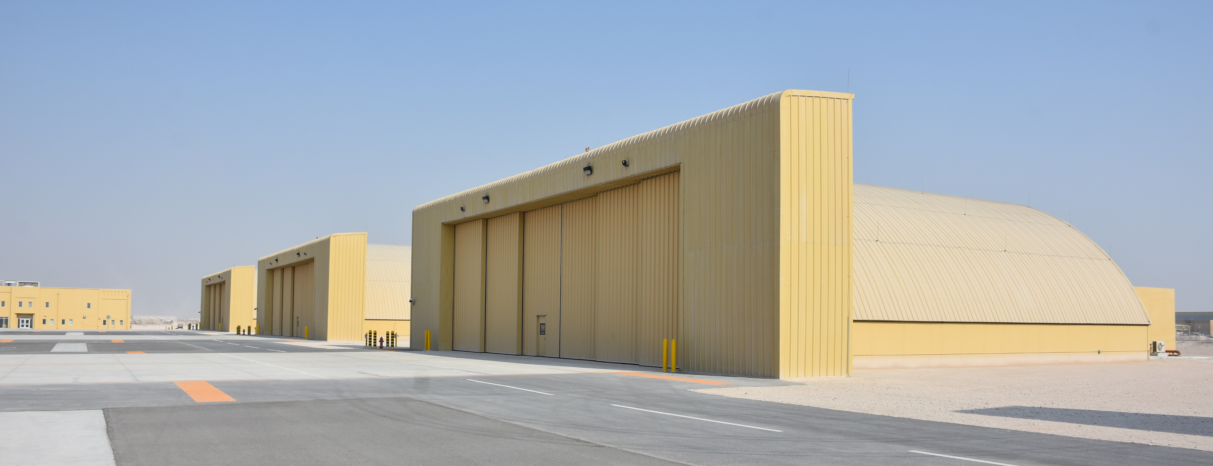
Falcon 3 Apache Quick Response
Al Udeid, Air Force Base, Doha, Qatar

Slide 22
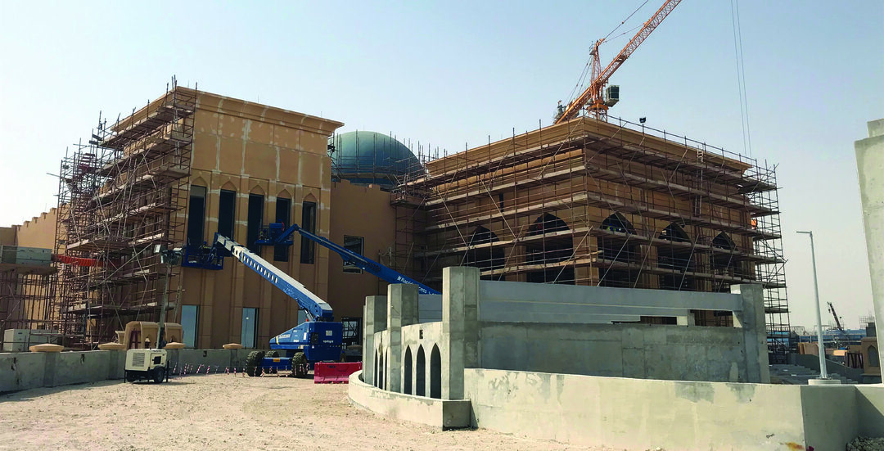
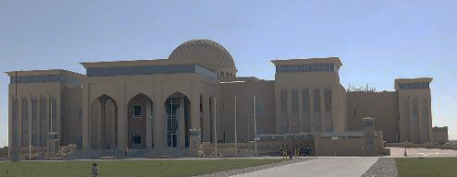
Shield 5
Qatar

Slide 23
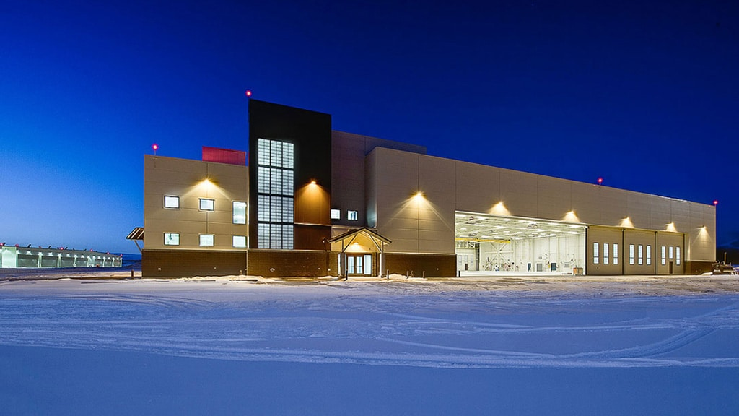
F22 Squad Operations
Joint Base Elmendorf-Richardson
Alaska

Slide 24

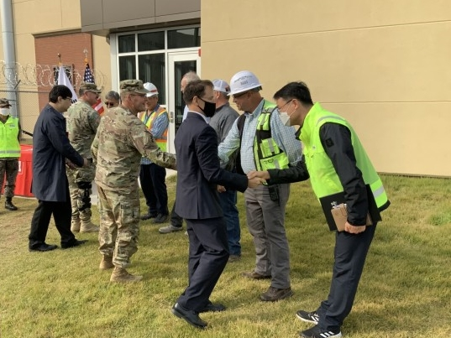
Battle Command Training Center
U.S. Army Garrison Humphreys
Republic of Korea

Slide 25
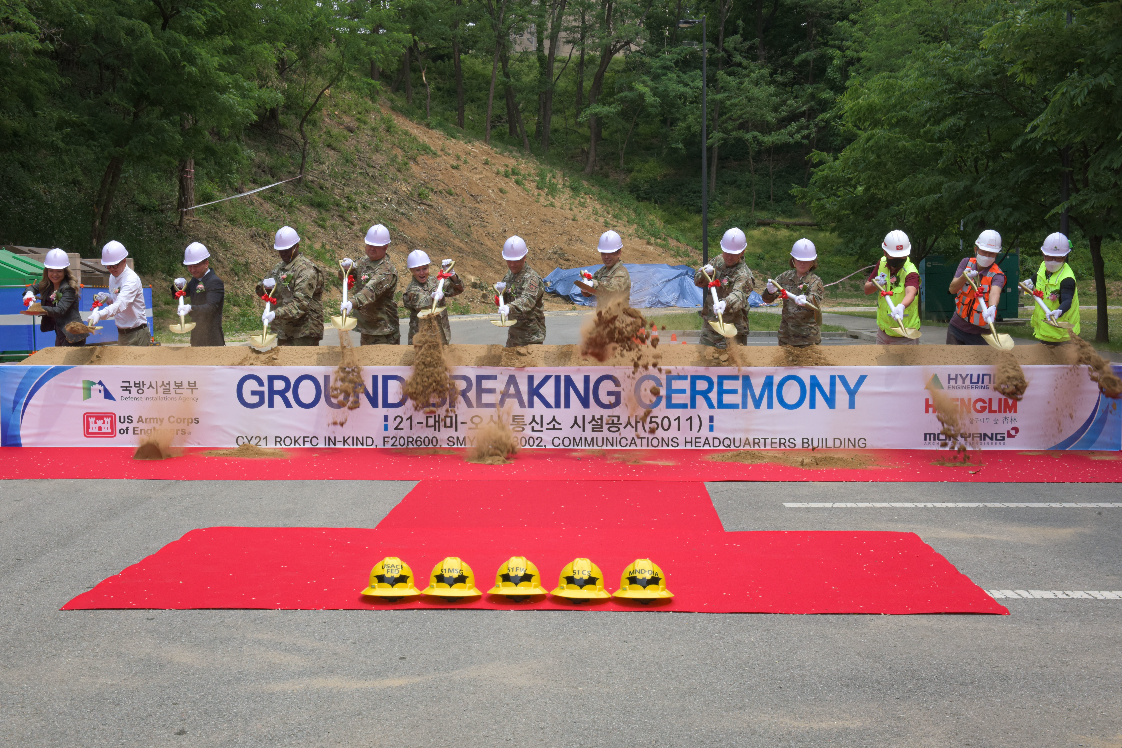
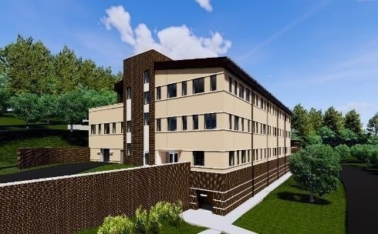
51 Communication Squadron Headquarters
Osian Air Base
Republic of Korea

Slide 26
Mongolian Kindergarten
Ulaangom, Mongolia

Slide 27


Khongsedon District Hospital
Laos

Slide 28

Per- and Polyfluoroalkyl Substances
USACE provides technical support to its military partners:
  identifying and testing for PFAS;
  executing responses to address these substances when found.
USACE supports research and development efforts through DOD-funded PFAS research and development, including:
  DOD’s Strategic Environmental Research and Development Program (SERDP)
  Environmental Security Technology Certification Program (ESTCP).
PFAS work enterprise-wide requires work acceptance approval at the USACE Headquarters level.

Slide 29

GUIDE TO DOING BUSINESS WITH USACE
How to Register
You must register your business in the System for Award Management (SAM) at https://www.sam.gov before submitting an offer or quote. Registration is free.
Contract Opportunities
Search for USACE contract opportunities at https://www.sam.gov/content/opportunities. Search by keyword, solicitation number, or District/Center name. Each contract opportunity is classified by a Product Service Code (PSC), and a North American Industry Classification System (NAICS) code.
Acquisition Regulations, Instruction, and Desk Guide
USACE contract awards and administration are governed by three regulations: Federal Acquisition Regulation (FAR), Defense Federal Acquisition Regulation Supplement (DFARS), and Army Federal Acquisition Regulation Supplement (AFARS), as well as an acquisition instruction with companion guide.
Locations
To find the U.S. Army Corps of Engineers’ locations, visit https://www.usace.army.mil/Missions/Locations/ and review the mission of each District/Center Contracting Office to determine your interest.

Slide 30
GUIDE TO DOING BUSINESS WITH USACE
Working outside of the United States and its territories
USACE operates under countless defense agreements when working overseas. In many locations, the agreements may restrict competition to local contractors or may require the host nation’s approval of offerors and awardees. Other countries utilize an indirect contracting system, where the host nation contracts for and administers the U.S. requirement under its laws and regulations. Some international agreements mandate direct solicitation of local offerors. Therefore, not all work contracted overseas will be eligible for competition.
Engagement ( 110 Countries )
Physical Presence ( 39 Countries )
Northwestern
Division
( Portland )
North
Atlantic
Division
( New York City )
Joint Contingency Contracting System (JCCS):
The JCCS is a real time contract data repository and reporting tool used by contracting offices overseas. To register in the Joint Contingency Contracting System (JCCS), visit https://www.jccs.gov/jccscoe/. The JCCS site allows contracting officers to confirm that a vendor has been verified as a legitimate entity in the country.
Trans-
Atlantic
Division
( Winchester, VA )
North
Atlantic
Division
( New York City )
Pacific
Ocean
Division
( Honolulu )
South
Atlantic
Division
( Atlanta )
Defense Base Act Insurance (DBA):
The Defense Base Act (DBA) (42 U.S.C. 1651 et seq.) provides workers compensation type insurance coverage for contractor employees performing under government contracts outside the United States.
Synchronized Predeployment and Operational Tracker (SPOT):
Register at: https://spot.dmdc.mil/default.aspx

Slide 31

Nome

Slide 32




FY23+ oconus business OPPORTUNTIES TRANSATLANTIC DIVISION
FY23 OCONUS Program
$3B
Future PSAB Modular Billeting, Kingdom of Saudi Arabia
Nome
Pier & Breakwater, Harbor House facility at Kuwait Naval Base
Medical and Dental Clinic, Bahrain

Slide 33
FY23+ OCONUS business OPPORTUNITIES
TRANSATLANTIC DIVISION
Opportunity* | Location | District / Center | Release Date (Qtr) | NAICS | Cost Range | Acquisition Strategy | Solicitation Type
Fuel Cell & Phase Maintenance Hangar | Jordan | Middle East (TAM) | Q1 FY23 | 236220 | $10-25M | Unrestricted | C-Type FFP
Bulk POL Storage | Jordan | Middle East (TAM) | Q1 FY23 | 236220 | $25-100M | Unrestricted | C-Type FFP
Egyptian Navy Equipment Sustainment Case | Egypt | Middle East (TAM) | Q1 FY23 | 333120 | $25-100M | Unrestricted | C-Type FFP
Multiple Award Task Order Contract (MATOC) Design Build/Design Bid Build | Syria | Expeditionary (TAE) | Q1 FY23 | 236220 | $100M Capacity/IDC | Unrestricted | IDIQ-Type FFP
Single Award Task Order Contract (SATOC) Iraq Personal Services | Iraq | Expeditionary (TAE) | Q1 FY23 | 541990 | $25M Capacity/IDC | Unrestricted | IDIQ-Type FFP
Zone 4 Microgrid Controller, Camp Arifjan | Kuwait | Expeditionary (TAE) | Q1 FY23 | 236220 | $10-25M | Unrestricted | C-Type FFP
MATOC Architect Engineer, | CENTCOM Wide | Middle East (TAM) | Q1FY23 | 541330 | $240M Capacity/IDC | Unrestricted | IDIQ-Type FFP
Job Order Contract, Kingdom of Saudi Arabia | Saudi | Middle East (TAM) | Q2 FY23 | 236220 | $50M Capacity/IDC | Unrestricted | IDIQ-Type FFP
Kuwait Ministry of Defense, Maintenance & Support Services, SATOC | Kuwait | Middle East (TAM) | Q2 FY23 | 561790 | $25M Capacity/IDC | Unrestricted | IDIQ-Type FFP
Design Build/Design Bid Build MATOC | Kuwait | Expeditionary (TAE) | Q2 FY23 | 236220 | $240M Capacity/IDC | Unrestricted | IDIQ-Type FFP
Replacement Job Order Contract, Kuwait | Kuwait | Expeditionary (TAE) | Q3 FY23 | 236220 | $75M Capacity/IDC | Unrestricted | IDIQ-Type FFP
*These projections are based on the best information available. They are subject to modification and are in no way binding on the Government. More specific information relating to any individual item or class of items will not be furnished until the proposed acquisition is synopsized through SAM.gov or the solicitation is issued."

Slide 34
FY23+ OCONUS business OPPORTUNITIES
TRANSATLANTIC DIVISION
Opportunity* | Location | District / Center | Release Date (Qtr) | NAICS | Cost Range | Acquisition Strategy | Solicitation Type
SATOC, A-E Tech Support, Maintenance, Design for Non-Perm Facilities | CENTCOM | Middle East (TAM) | Q2 FY23 | 541330 | $9M Capacity/IDC | Unrestricted | IDIQ-Type FFP
SATOC, A-E Construction Phase Support Services | CENTCOM | Middle East (TAM) | Q3 FY23 | 541330 | $75M Capacity/IDC | Unrestricted | IDIQ-Type FFP
Construct/Renovate Warehouses, 35th Brigade | Kuwait | Middle East (TAM) | Q4 FY23 | 236220 | $25-100M | Unrestricted | C-Type FFP
RUNWAY 08/26 REPAIR | Jordan | Middle East (TAM) | Q1 FY24 | 237310 | $10-25M | Unrestricted | C-Type FFP
Hamat Air Base Phase 1 | Lebanon | Middle East (TAM) | Q2 FY24 | 236220 | $5-10M | Unrestricted | C-Type FFP
Advance Intelligence Center | Jordan | Middle East (TAM) | Q3 FY24 | 236220 | $1-5M | Unrestricted | C-Type FFP
Restore Beirut Naval Base, Phase 1 | Lebanon | Middle East (TAM) | Q4 FY24 | 236220 | $10-25M | Unrestricted | C-Type FFP
USASAC Case CH-47F Hangers | Egypt | Middle East (TAM) | Q4 FY24 | 236220 | $25-100M | Unrestricted | C-Type FFP
P221 Aircraft Ready Fuels Storage | Bahrain | Middle East (TAM) | Q4 FY24 | 236220 | $25-100M | Unrestricted | C-Type FFP
Border Security Barriers | Jordan | Middle East (TAM) | Q4 FY24 | 236220 | $5-10M | Unrestricted | C-Type FFP
*These projections are based on the best information available. They are subject to modification and are in no way binding on the Government. More specific information relating to any individual item or class of items will not be furnished until the proposed acquisition is synopsized through SAM.gov or the solicitation is issued."

Slide 35

Nome

Slide 36






USACE Support IN Europe
Strategically Critical Programs
European Deterrence Initiative (EDI)
Poland Provided Infrastructure (PPI)
NATO Security Investment Program (NSIP)
Arm/Disarm Pad, Graf Ignatievo, Bulgaria
Runaway Ribbon Cutting
Łask, Poland
Poland Provided Infrastructure
Squadron Ops Facility Upgrades, Lithuania
NATO Long Term Equipment Storage and Maintenance Complex (LTESM-C), Powidz, Poland
  EDI projects provide key infrastructure for rotating US and NATO forces
  Typical Army Projects: Railheads, Ammunition Loading Areas, Warehouses, Classrooms, and Range Operation Buildings.
  Typical Air Force Projects: Taxiway, Fueling Facilities, Runways, Parking Aprons, Munitions Storage, Hangars, Squad Ops, and Hot Cargo Pads.
Challenges
  Remote location of project sites.
  Host Nation review and approval process for designs
  Current Conflict in Eastern Europe.
Poland Funded/Contracted Construction Projects
Typical Projects: Staging Areas, Deployable Air Base Systems, Bulk Fuel Storage, Barracks, Parking Aprons, Hangars
US to contract for Secure Construction (i.e. Comm or Information System Facilities)
NSIP/UMMC-A Funded: LTESM-C, Powidz
USACE Technical Services in Poland: Area Development Plans, Criteria Development, Design, Construction, Engineering and Construction Surveillance
Fire Station, Lielvarde, Latvia
LTESM-C Warehouses
Dormitory, Estonia
LTESM-C Vehicle Maintenance

Slide 37
FY23+ OCONUS business OPPORTUNITIES
NORTH ATLANTIC
Opportunity* | Location | District / Center | Release Date (Qtr) | NAICS | Cost Range | Acquisition Strategy | Solicitation Type
Family Housing Replacement | Baumholder, Germany | Europe (NAU) | FY23 1QTR | 236116 | $25M-$100M | Unrestricted | C-Type FFP
Petroleum, Oil, and Lubricants (POL) Jet Fuel Storage | Hungary | Europe (NAU) | FY23 1QTR | 236220 | $10M-$25M | Unrestricted | C-Type FFP
Parallel Taxiway | Hungary | Europe (NAU) | FY23 1QTR | 237310 | $25M-$100M | Unrestricted | C-Type FFP
Fighter parking apron, cargo road, dangerous cargo pad, open storage/marshalling area, & mast lighting | Hungary | Europe (NAU) | FY23 1QTR | 236220 | $25M-$100M | Unrestricted | C-Type FFP
Deployable Air Base System Storage Facilities: humidity-controlled warehouses, general purpose warehouses, & refueling vehicle maintenance shop. | Luxembourg | Europe (NAU) | FY23 1QTR | 236220 | $25M-$100M | Unrestricted | C-Type FFP
Sensitive Compartmented Information Facility (SCIF) Operations Facilities | Baumholder, Germany | Europe (NAU) | FY23 2QTR | 236220 | $25M-$100M | Unrestricted | C-Type FFP
SCIF Battalion Facilities | Baumholder, Germany | Europe (NAU) | FY23 2QTR | 236220 | $25M-$100M | Unrestricted | C-Type FFP
SCIF Support Facilities | Baumholder, Germany | Europe (NAU) | FY23 2QTR | 236220 | $25M-$100M | Unrestricted | C-Type FFP
SCIF Communications Facilities | Baumholder, Germany | Europe (NAU) | FY23 2QTR | 236220 | $5M-$10M | Unrestricted | C-Type FFP
Ten Cell Earth Berm Ammunition Holding Area | Bulgaria | Europe (NAU) | FY23 2QTR | 236220 | $5M-$10M | Unrestricted | C-Type FFP
*These projections are based on the best information available. They are subject to modification and are in no way binding on the Government. More specific information relating to any individual item or class of items will not be furnished until the proposed acquisition is synopsized through SAM.gov or the solicitation is issued."

Slide 38
FY23+ OCONUS business OPPORTUNITIES
NORTH ATLANTIC
Opportunity* | Location | District / Center | Release Date (Qtr) | NAICS | Cost Range | Acquisition Strategy | Solicitation Type
Deployable Air Base System FEV Storage Facilities | Hungary | Europe (NAU) | FY23 2QTR | 236220 | $25M-$100M | Unrestricted | C-Type FFP
Explosives and ammunition loading and unloading apron | Romania | Europe (NAU) | FY23 2QTR | 236220 | $10M-$25M | Unrestricted | C-Type FFP
New Family Housing | Vicenza Italy | Europe (NAU) | FY23 2QTR | 236116 | $25M-$100M | Unrestricted | C-Type FFP
Vehicle Parking Pavement | Longare, Italy | Europe (NAU) | FY23 4QTR | 237310 | $5M-$10M | Unrestricted | IDIQ-Type FFP
Company Operations Facilities | Baumholder, Germany | Europe (NAU) | FY24 1QTR | 236220 | $25M-$100M | Unrestricted | Stand Alone "C" Contract
Area Protective Barrier | Baumholder, Germany | Europe (NAU) | FY24 1QTR | 236220 | $1M-$5M | Unrestricted | MATOC
Beddown Site Prep | Norway | Europe (NAU) | FY24 1QTR | 236220 | $5M-$10M | Unrestricted | Stand Alone "C" Contract
Perimeter Fence | Norway | Europe (NAU) | FY24 1QTR | 236220 | $5M-$10M | Unrestricted | Stand Alone "C" Contract
Earth-covered magazines (ECMs), security entry control building, munitions shop, spares storage, munitions maintenance pad, bomb preload station, barricade yard | Norway | Europe (NAU) | FY24 1QTR | 236220 | $25M-$100M | Unrestricted | Stand Alone "C" Contract
Joint Parachute Rigging Facility | Baumholder, Germany | Europe (NAU) | FY24 2QTR | 236220 | $10M-$25M | Unrestricted | Stand Alone "C" Contract
Human Performance Training Center | Baumholder, Germany | Europe (NAU) | FY24 2QTR | 236220 | $10M-$25M | Unrestricted | Stand Alone "C" Contract
*These projections are based on the best information available. They are subject to modification and are in no way binding on the Government. More specific information relating to any individual item or class of items will not be furnished until the proposed acquisition is synopsized through SAM.gov or the solicitation is issued."

Slide 39
FY23+ OCONUS business OPPORTUNITIES
NORTH ATLANTIC
Opportunity* | Location | District / Center | Release Date (Qtr) | NAICS | Cost Range | Acquisition Strategy | Solicitation Type
New Family Housing | Baumholder, Germany | Europe (NAU) | FY24 2QTR | 236116 | $25M-$100M | Unrestricted | Stand Alone "C" Contract
Family Housing Replacement | Baumholder, Germany | Europe (NAU) | FY24 2QTR | 236116 | $25M-$100M | Unrestricted | Stand Alone "C" Contract
Sensitive Compartmented Information Facility Operations Facility | Estonia | Europe (NAU) | FY24 2QTR | 236220 | $5M-$10M | Unrestricted | Stand Alone "C" Contract
Deployable Air Base System Storage Facilities: humidity-controlled warehouses, general purpose warehouses, & refueling vehicle maintenance shop. | Norway | Europe (NAU) | FY24 2QTR | 236220 | $25M-$100M | Unrestricted | Stand Alone "C" Contract
Arm/disarm pad and parking apron | Slovakia | Europe (NAU) | FY24 4QTR | 236220 | $1M-$5M | Unrestricted | Stand Alone "C" Contract
Petroleum, Oil, and Lubricants (POL) Jet Fuel Storage | Slovakia | Europe (NAU) | FY24 4QTR | 236220 | $10M-$25M | Unrestricted | Stand Alone "C" Contract
Parking apron, arm/disarm pad, roadways, and runway hammerhead | Slovakia | Europe (NAU) | FY24 4QTR | 236220 | $10M-$25M | Unrestricted | Stand Alone "C" Contract
Earth-covered magazines (ECMs), security entry control building, munitions shop, spares storage, munitions maintenance pad, bomb preload station, barricade yard | Slovakia | Europe (NAU) | FY24 4QTR | 236220 | $25M-$100M | Unrestricted | Stand Alone "C" Contract
*These projections are based on the best information available. They are subject to modification and are in no way binding on the Government. More specific information relating to any individual item or class of items will not be furnished until the proposed acquisition is synopsized through SAM.gov or the solicitation is issued."

Slide 40

Nome

Slide 41






FY23+ oconus business OPPORTUNITIES pacific ocean division
Foreign OCONUS | Non-Foreign OCONUS | Total POD (OCONUS)
$894.9M | $755.7M | $1,650.6M
POD’s FY23 foreign overseas requirements where US firms are able to compete for are primarily located in Kwajalein. Kwajalein construction projects less than $50M will be competed against a design-build and design-bid-build Multiple Award Task Order Contract currently being evaluated and scheduled to award in 2Q FY23. Construction projects greater than $50M will be part of a pre-qualification process that will be advertised later in 1Q FY23
Runway Extension, AK (Rendering)
Child Development Center, HI (Rendering)
Replace Fuel Storage Tanks, Kwajalein Atoll

Slide 42
FY23+ OCONUS business OPPORTUNITIES pacific ocean division
Opportunity* | Location | District / Center | Release Date (Qtr) | NAICS | Cost Range | Acquisition Strategy | Solicitation Type
84 PN Dorm (CLR049) | Clear SFS, AK | Alaska (POA) | 1Q FY23 | 236220 | $25M-$100M | DB UNR | C Type
Arctic Permafrost Research Facility (FTW428A) | Fort Wainwright, AK | Alaska (POA) | 2Q FY23 | 236220 | $5M-$10M | DBB TBD | C Type
Physical Readiness Fieldhouse (FTW453) | Fort Wainwright, AK | Alaska (POA) | 4Q FY23 | 236220 | $25M-$100M | DB UNR | C Type
AKARNG Readiness Center (JBR032) | Joint Base Elmendorf-Richardson (JBER) | Alaska (POA) | 1Q FY24 | 236220 | $25M-$100M | TBD UNR | C Type
Maintenance Support Facility (FTG251) | Fort Greely, AK | Alaska (POA) | 1Q FY24 | 236220 | $25M-$100M | DBB UNR | C Type
HC130J Simulator Facility (JBE077) | Joint Base Elmendorf-Richardson (JBER) | Alaska (POA) | 3Q FY24 | 236220 | $10M-$25M | TBD | C Type
AKANG Base Supply Complex (JBE079) | Joint Base Elmendorf-Richardson (JBER) | Alaska (POA) | 3Q FY24 | 236220 | $25M-$100M | TBD | C Type
Barracks (FTW371) | Fort Wainwright, AK | Alaska (POA) | 4Q FY24 | 236220 | $100M-$250M | DB UNR | C Type
Port of Nome Harbor Modification | Nome, AK | Alaska (POA) | 2Q FY23 | 237990 | $25M-$100M | DBB UNR | C Type
*These projections are based on the best information available. They are subject to modification and are in no way binding on the Government. More specific information relating to any individual item or class of items will not be furnished until the proposed acquisition is synopsized through SAM.gov or the solicitation is issued."

Slide 43
FY23+ OCONUS business OPPORTUNITIES pacific ocean division
Opportunity*c | Location | District / Center | Release Date (Qtr) | NAICS | Cost Range | Acquisition Strategy | Solicitation Type
Craig Harbor Breakwater | Craig, AK | Alaska (POA) | 2Q FY23 | 237990 | $25M-$100M | DBB UNR | C Type
Petersburg Navigation Improvements | Petersburg, AK | Alaska (POA) | 2Q FY23 | 237990 | $5M-$10M | DBB SB | C Type
Ketchikan Bar Point Breakwater Replacement | Ketchikan, AK | Alaska (POA) | 2Q FY23 | 237990 | $10M-$25M | DBB SB | C Type
Kenai Bluffs Erosion Protection | Kenai, AK | Alaska (POA) | 3Q FY24 | 237990 | $10M-$25M | DBB TBD | C Type
Dillingham Harbor Maintenance Dredging | Dillingham, AK | Alaska (POA) | 1Q FY24 | 237990 | $5M-$10M | DBB SB | C Type
Homer Harbor and Ninilchik Harbor Maintenance Dredging | Homer and Ninilchik, AK | Alaska (POA) | 1Q FY24 | 237990 | $5M-$10M | DBB SB | C Type
Petroleum, Oil, Lubricant (POL) IDIQ | Alaska & USPACOM AOR | Alaska (POA) | 1Q FY23 | 237120 | $45M | DB/DBB 8A | IDC
Various Environmental Services​ (Environmental Quality Support Services) | Alaska | Alaska (POA) | 1Q FY23​ | 562910​ | $25M-$100M​ | SB | MATOC​
Remedial Design / Limited Remedial Action​ (Former Umiat AF Station) | Alaska | Alaska (POA) | 2Q FY23​ | 562910​ | $25M-$100M​ | TBD | SATOC
Various Environmental Services​ (Army and Air Force) | Alaska, Various | Alaska (POA) | 3Q FY23​ | 562910​ | $10M-$25M | Various​ | Various​
Various Environmental Services​ (Formerly Used Defense Sites) | Alaska, Various | Alaska (POA) | 3Q FY23​ | 562910​ | $10M-$25M | Various​ | Various​
*These projections are based on the best information available. They are subject to modification and are in no way binding on the Government. More specific information relating to any individual item or class of items will not be furnished until the proposed acquisition is synopsized through SAM.gov or the solicitation is issued."

Slide 44
FY23+ OCONUS business OPPORTUNITIES pacific ocean division
Opportunity* | Location | District / Center | Release Date (Qtr) | NAICS | Cost Range | Acquisition Strategy | Solicitation Type
Remediation Services​ (Environmental) | Hawaii, Various | Honolulu (POH) | 3Q FY23​ | 236220​ | $25M-$100M​ | TBD​ | TBD​
FY23 MCA PN80242 Medical Clinic | Kwajalein Atoll | Honolulu (POH) | 3Q FY23 | 236220 | $25M-$100M | DBB UNR | C Type
FY20 MCA PN64063 Air Traffic Control Tower | Kwajalein Atoll | Honolulu (POH) | 3Q FY23 | 236220 | $25M-$100M | DBB UNR | TBD
FY22 MCA PN93668 Aviation Unit Operations BLDGS | Wheeler Army Airfield, Oahu | Honolulu (POH) | 4Q FY23 | 236220 | $25M-$100M | DBB UNR | C Type
FY18 AFH PN65981 Family Housing Replacement Construction | Kwajalein Atoll | Honolulu (POH) | 4Q FY23 | 236115 | $25M-$100M | DB UNR | C Type
FY22 MCA PN80133 Ammunition Storage | West Loch, Oahu | Honolulu (POH) | TBD | 237990 | $25M-$100M | DBB UNR | TBD
*These projections are based on the best information available. They are subject to modification and are in no way binding on the Government. More specific information relating to any individual item or class of items will not be furnished until the proposed acquisition is synopsized through SAM.gov or the solicitation is issued."

Slide 45


USNORTHCOM
USACE District Offices
USSOUTHCOM
Nome

Slide 46




FY23+ OCONUS business OPPORTUNITIES
South Atlantic DIVISION
FY22 OCONUS Awards
$357M
The South Atlantic Division’s FY23+ Construction and Architect/Engineering requirements are focused on delivering facilities for the Army, Air Force, and federal partners throughout the southeast, along with Central and South America. There are also opportunities for support services to assist in the delivery of environmental and civil works projects.
SAM POC: IIS Chief, Julie Walton, Julie.H.Walton@usace.army.mil ; SAJ POC: IIS Chief, Mike Ornella, Michael.A.Ornella@usace.army.mil

Slide 47
FY23+ OCONUS business OPPORTUNITIES south Atlantic DIVISION
Opportunity | Location | District / Center | Release Date (Qtr) | NAICS | Cost Range | Acquisition Strategy | Solicitation Type
SATOC for Small Repair and Construction Requirements in Peru | Peru | SAM | 1Q FY23 | 236220 | $5-10M | Unrestricted | IDIQ
PN DESC2402 – FY24 Aviation Fuel Storage Facility | Honduras | SAM | 2Q FY23 | 236220 | $25-100M | Unrestricted | “C” Type
Phase 1a Peruvian Navy Warehouse and Admin Facilities, Port of Callao, Peru | Peru | SAM | 2Q FY23 | 236220 | $25-100M | Unrestricted | “C” Type
Ramey Elementary School DBB San Juan, PR | Puerto Rico | SAS | TDB | 541330 | $75-100M | Unrestricted | “C” Type
Two-Phase Design-Build MATOC IDIQ for Construction Requirements in Central America | Central America | SAM | 3Q FY23 | 236220 | $100-250M | Unrestricted | IDIQ
PRARNG Ft. Allen Readiness Center | Puerto Rico | SAJ | 4QFY23 | 236220 | $25-100M | Unrestricted | “C” Type
VIARNG Army Aviation Facility/Combined Support Training Facility | St Croix | SAJ | 1QFY24 | 236220 | $10-25M | Unrestricted | “C” Type
Design Build San Juan VA Medical Center Seismic Retrofit | Puerto Rico (PR) | SAS | FY24/25 | 236220 | $500-750M | Unrestricted | IDIQ -MATOC
VIARNG St. Croix Vehicle Maintenance Shop | St Croix | SAJ | TDB | 236220 | $10-25M | Unrestricted | “C” Type
*These projections are based on the best information available. They are subject to modification and are in no way binding on the Government. More specific information relating to any individual item or class of items will not be furnished until the proposed acquisition is synopsized through SAM.gov or the solicitation is issued."

Slide 48
FY23+ OCONUS business OPPORTUNITIES south Atlantic DIVISION
Opportunity | Location | District / Center | Release Date (Qtr) | NAICS | Cost Range | Acquisition Strategy | Solicitation Type
Army Reserve Center | Ft. Buchanan, PR | LRL | 2Q FY23 | 236220 | $10-25M | Unrestricted | “C” Type
Juana Diaz Microgrid | Ponce, PR | LRL | 1Q FY24 | 236220 | $10-25M | Unrestricted | “C” Type
Ramey Microgrid | Aguadilla, PR | LRL | 1Q FY24 | 236220 | $10-25M | Unrestricted | “C” Type
Ft. Buchanan Installation Microgrid | Ft. Buchanan, PR | LRL | 1Q FY25 | 236220 | $25-100M | Unrestricted | “C” Type
Potable Water Reclamation | Ft. Buchanan, PR | LRL | FUTURE | 236220 | $5-10M | TBD | “C” Type
Mobile District Small Business Office: https://www.sam.usace.army.mil/Business-With-Us/Small-Business/
Jacksonville District Small Business Office: https://www.saj.usace.army.mil/SmallBusiness/
*These projections are based on the best information available. They are subject to modification and are in no way binding on the Government. More specific information relating to any individual item or class of items will not be furnished until the proposed acquisition is synopsized through SAM.gov or the solicitation is issued."

Slide 49


Questions ?
ESSAYONS!
People / Readiness / Partnerships / Revolutionize

Slide 50


USACE FMS Full and open Future SOLICITATIONS
District | Country | Program | Contract Description | Estimated Advertise Date
Middle East District | Kuwait | FMS | Construct Dive Recompression Chamber | FY23 Q1
Middle East District | Kuwait | FMS | Patriot Sites Support: D&C (MADF) | FY23 Q4
Middle East District | Saudi Arabia | FMS | RSLFAC Phase 2 Pkg 3 | FY23 Q1
Middle East District | Saudi Arabia | FMS | RSLFAC Phase 2 Pkg 1 | FY23 Q1
Middle East District | Saudi Arabia | FMS | RSLFAC Phase 2 Pkg 4 | FY23 Q1
Middle East District | Saudi Arabia | FMS | THAAD Construction Priority 2 Site | FY23 Q3
Middle East District | Saudi Arabia | FMS | THAAD Construction Priority 3 Site | FY23 Q3
Europe District | Israel | FMS | Prefab Concrete Elements SATOC | FY23Q2
Europe District | Israel | FMS | Runways SATOC | FY23 Q2
Honolulu District | Marshall Island | 333 | Security Fence at Port of Majuro | FY23 Q1
NATO - Shape International School Complex
India C-17 Bed-down Facilities
USACE International Industry Days
District: Middle East District
When: Q2/Q3 2023
Where: In Lebanon (Exact Location TBD) for Beirut Naval Base and Hamat Air Base.

Slide 51
INTERNATIONAL Environmental SUPPORT:
CAPABILITIES
POTENTIAL AREAS OF ASSISTANCE
AREAS OF INTEREST | CAPABILITIES
Ordnance Clearance and Support. | Full range of services to address unexploded ordnance, discarded military munitions, and munitions constituents (including conventional and/or chemical warfare materiel). Mine clearance of ranges, construction sites and battlefield areas. Destruction of expired or captured munitions.
Environmental Waste Disposal. | Minimization, removal, transport, classification and proper disposal of environmental waste.
Environmental Remediation. | DOD-recognized Center of Expertise, specializing in remediation of environmental and munition contamination.
Archaeological Curation. | State-of-the art technical expertise in curating and managing archaeological collections, to include mass grave investigations.
Geospatial Support. | Airborne assets fleet capable of performing imagery (better than 5 cm) and LIDAR (50 cm) collection; Forward-deployable GIS professionals available to support collection, integration, analysis and exploitation of all geospatial data.

