Slide 1



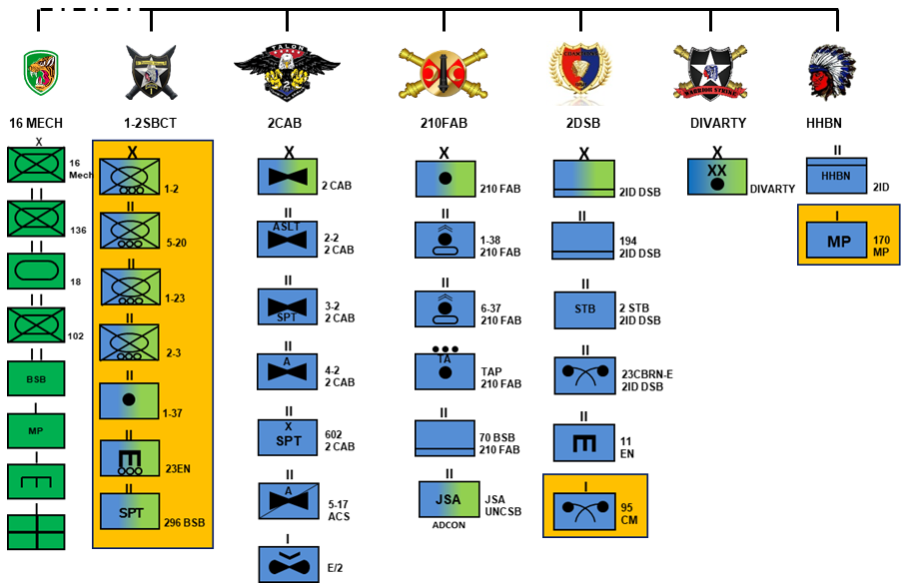


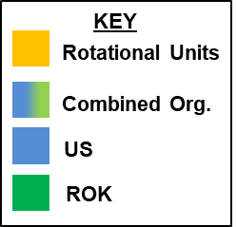









FIGHT TONIGHT!
Second to None
2nd Infantry Division, ROK-US Combined Division (RUCD)
2ID/RUCD on PEN
NORTH KOREA
Task Organization
Hamhung
Camp Bonifas
Mission: 2ID/RUCD defends the Korean peninsula from external threats and, on order, transitions to offensive large scale combat operations to defeat all forces of the Democratic People’s Republic of Korea (DPRK)
I
JSA
UNCSB
USAG Humphreys
Pyongyang
JSA
XX
Pocheon, Ildong-myeon
2ID/RUCD
DMZ
X
X
Haeju
JSA
16 MECH
XX
CP Casey
Camp Casey/Hovey
DIVARTY
SEOUL
X
Key Tasks:
-Non-Combatant Evacuation Operations (NEO)
-Maritime Counter SOF (MCSOF)
-Counter Fire Task Force (CFTF)
-Integrate external forces to generate combat power
Conduct offensive operations north of the Military Demarcation Line (MDL)
Incheon
Yongsan
SBCT
X ⁽⁻⁾
Yongin
SBCT
2 CAB
Osan AB
X
X
Largest special operation force (SOF)
3rd largest chem stockpile
4th largest military in the world
CP Humphreys
210 FAB
REPUBLIC OF KOREA
GOC, Yongin
II
2ID DSB
Seoul Air Base
CFTF
HQs
E
299EN
II
2-2
2 CAB
ASLT
II
M
SPT
1xRBCT
BSB
Q3 FY25 |  |  |  |  |  |  |  |  |  |  |  |  | Q4 FY25 |  |  |  |  |  |  |  |  |  |  |  |  | Q1 FY26 |  |  |  |  |  |  |  |  |  |  |  |  | Q2 FY26
April-25 |  |  |  |  | May-25 |  |  |  | Jun-25 |  |  |  | Jul-25 |  |  |  |  | Aug-25 |  |  |  | Sep-25 |  |  |  | Oct-25 |  |  |  | Nov-25 |  |  |  | Dec-25 |  |  |  |  | Jan-26 |  |  |  | Feb-26 |  |  |  | Mar-26
TW 26 | TW 27 | TW 28 | TW 29 | TW 30 | TW 31 | TW 32 | TW 33 | TW 34 | TW 35 | TW 36 | TW 37 | TW 38 | TW 39 | TW 40 | TW 41 | TW 42 | TW 43 | TW 44 | TW 45 | TW 46 | TW 47 | TW 48 | TW 49 | TW 50 | TW 51 | TW 01 | TW 02 | TW 03 | TW 04 | TW 05 | TW 06 | TW 07 | TW 08 | TW 09 | TW 10 | TW 11 | TW 12 | TW 13 | TW 14 | TW 15 | TW 16 | TW 17 | TW 18 | TW 19 | TW 20 | TW 21 | TW 22 | TW 23 | TW 24 | TW 25
E3B
KRF 16 RIP/TOA
Pacific
Fortitude (T)
UFS 25
KRF 17 NTC
Courageous Channel
(NEO)
FS 26
KCTC 25-2
WFX
CPX 1
1
KCTC 25-7
K-ICTC
3
4
5
KCTC 25-10
Warrior Focus
2
WFX
Academics
WFX
CPX 3
WFX
26-01
2ID Readiness
ROAD TO WFX
OPS
Tomahawk
WFX
CPX 2
AH-64 Gunnery
PLT
ARTEP
PLT
ARTEP
PLT
ARTEP
CFTF
FTX
MLRS
LFX
ACL LOADEX
KICTC
MLRS
LFX
Orient
Shield
AASLT
Combined
SUST Gunnery
FIGHT TONIGHT!
S2S
AH-64 Gunnery
WGX
PLT
ARTEP
GCC
CCX
MLRS
LFX
MLRS
LFX
Hazard Response
GMLRS LFX
Q64&Q53
CPPG
SCLFX
KRF Life Cycle
END GAME
Individual Readiness
Holistic Services
Leader Development
KCTC
KRF
Transition
READINESS
4x Regt METs “T”
37x SQDN METs “T”
12x Troop CALFEX
39x PLT LFX
AT XII and first M777 ATXV
>60 ROKA Combined TRNG
2,262,214 Rounds Fired
(4,800 Artillery and Mortar)
45,000 miles driven
KRF
Transition
SQD LFX
PLT LFX
CALFEX
E3B
RE-CERT
/Gunnery
Gunnery
Artillery Lethality
TBL VI
TBL XII
TBL XV
TBL XVIII
Sustainment Readiness
CPP LFX Crew
CPP LFX Section
Convoy Escort TM
Protection
EQT III
EQT IV
EQT V

Slide 2
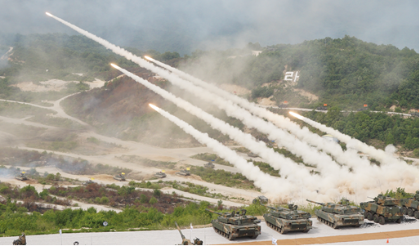
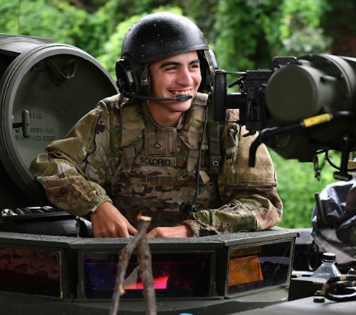
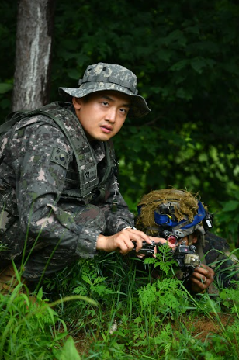
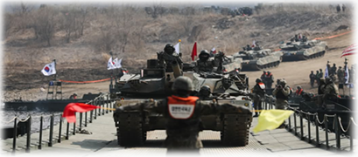

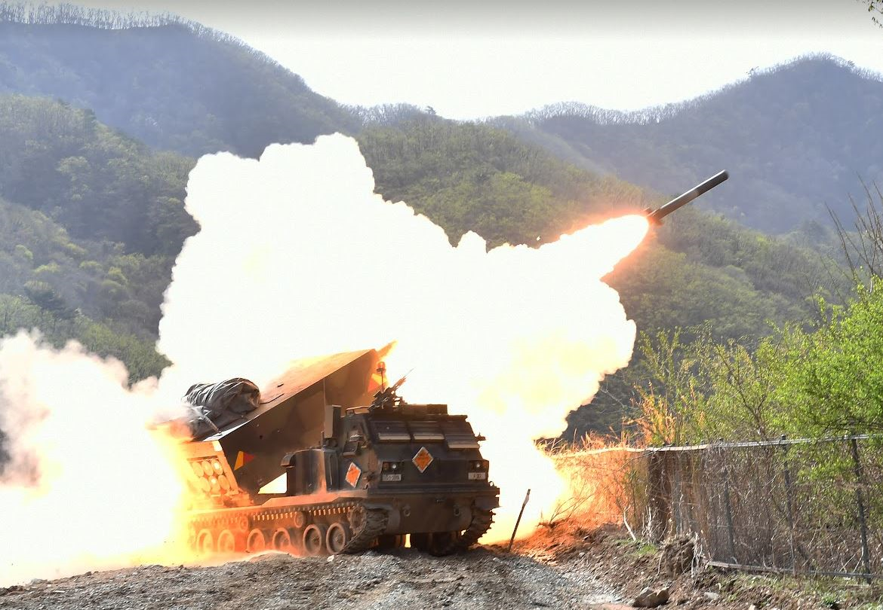
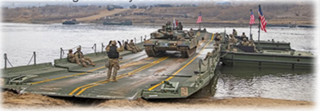
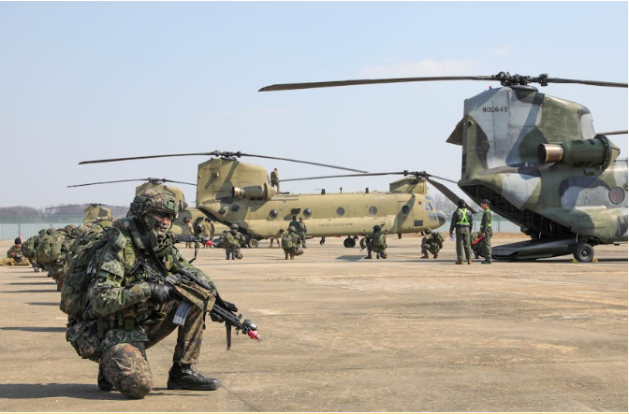
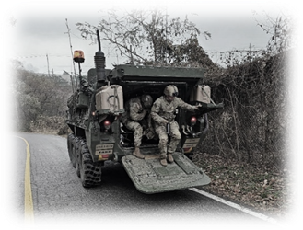
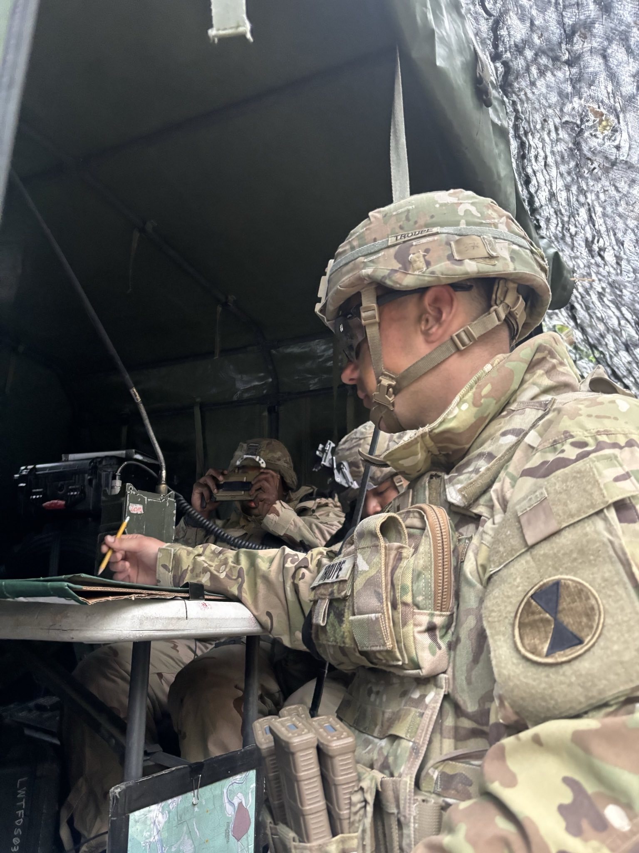
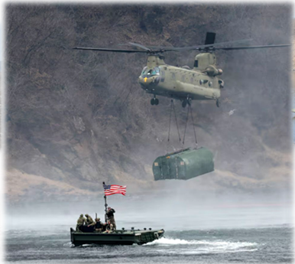
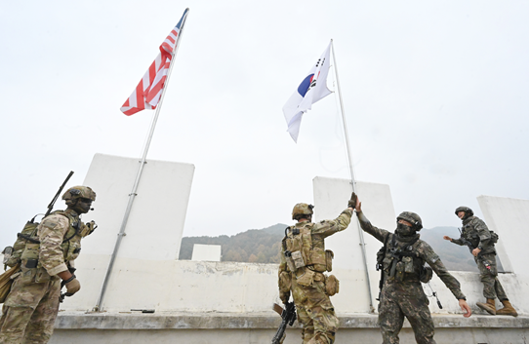
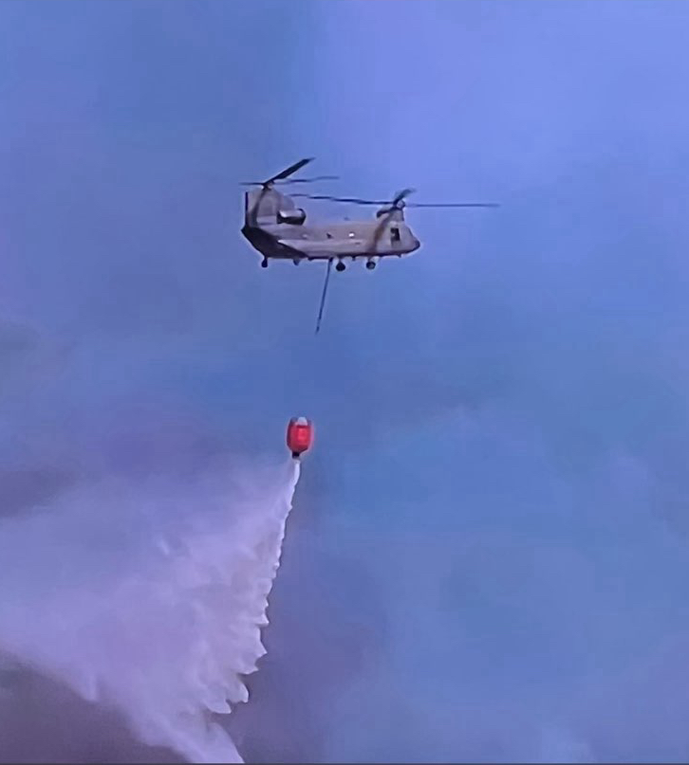
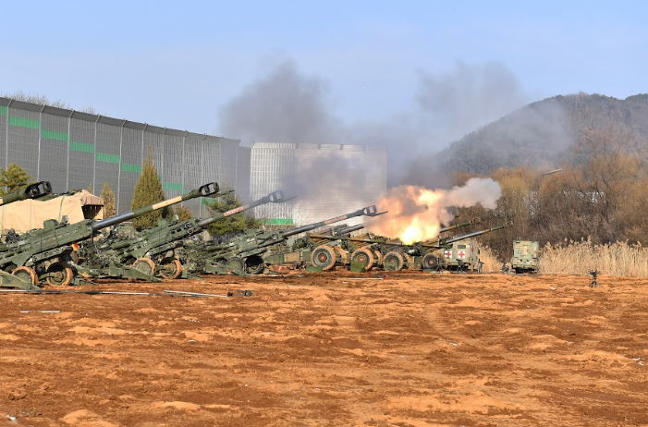
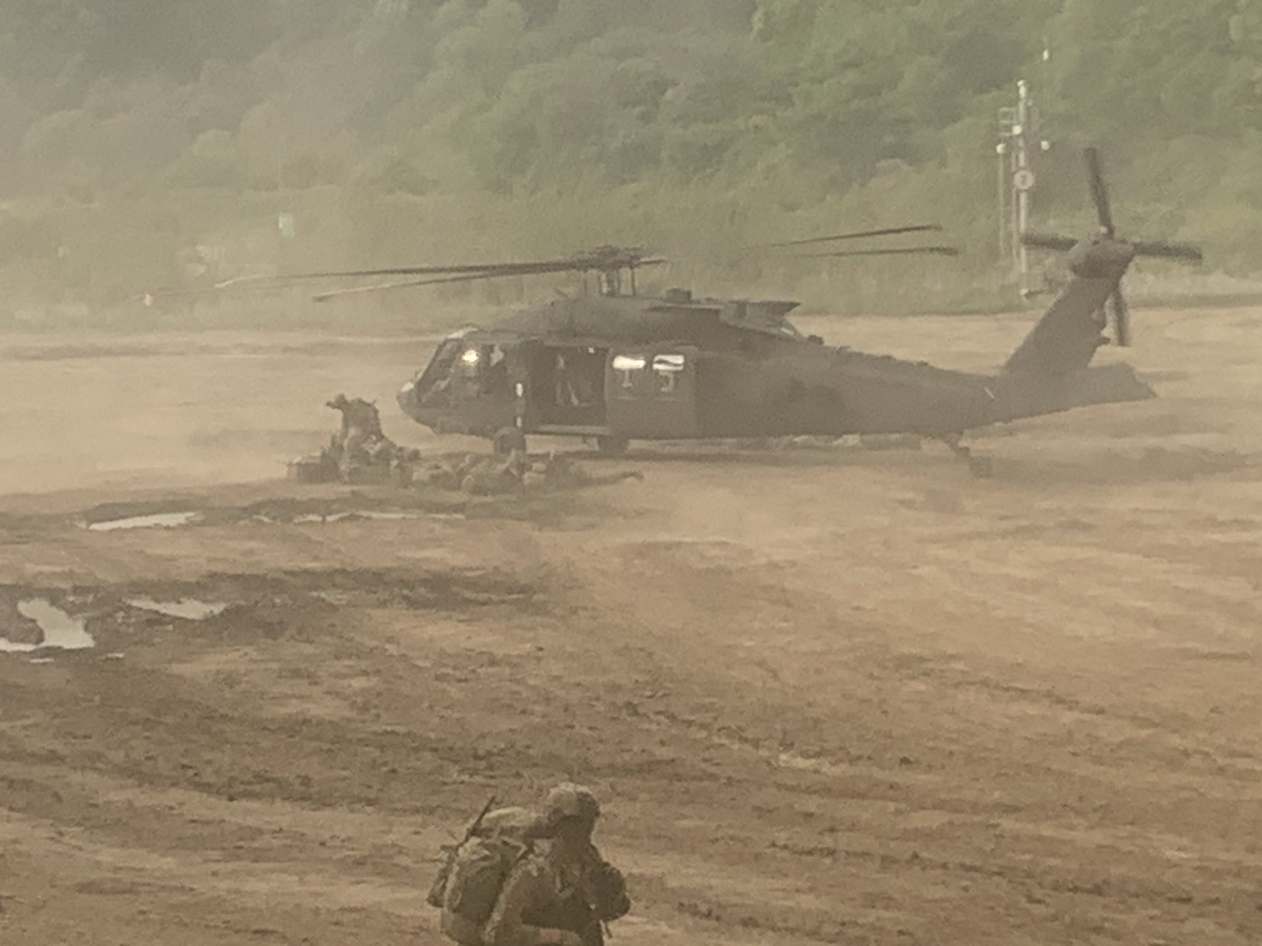
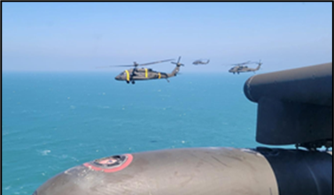
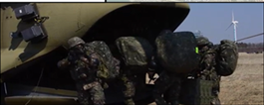
Lethal Counterfire Capability
Combined Allied Exercises
The Combined Division
Building Joint Readiness
Combined Arms Competency
Multidomain Convergence

