Slide 1
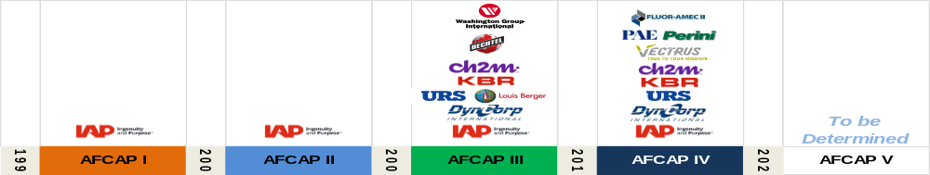





Air Force Contract Augmentation Program (AFCAP V)
AFCAP Provides world-wide military and civil support to satisfy requirements for any U.S. Federal Government agency, NATO, and multi-national forces.
Military and Civil Support includes: Services; Construction/ Facilities; Logistics Support; Commodities
Indefinite Delivery/Indefinite Quantity (ID/IQ) contract administered by Air Force Installation Contracting Center (AFICC)
Client: Air Force Civil Engineer Center (AFCEC)
AFCAP V was awarded in 2020 for an Eight Year Period of Performance with a $15B Capacity (recent mod – increase from $6.3B) with 6 awardees: Fluor, V2X, ECC, KBR, RMS (IAP), Amentum
Contracting Office: AFICC (772 ESS)/Task Order Types: FFP, CPFF, CPAF, CPIF
1

Slide 2
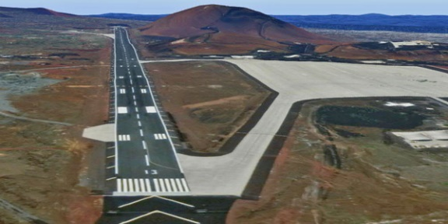
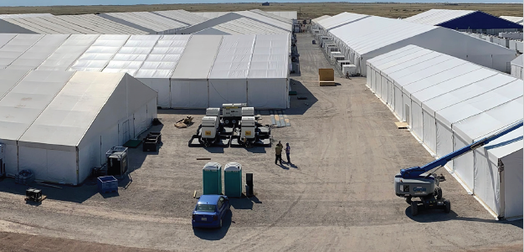
Past Projects
Ascension Island Runway Repair – AFCAP IV
Ascension Island, St Helena, UK
Operation Allies Welcome – AFCAP V
Holloman AFB, NM
2

Slide 3
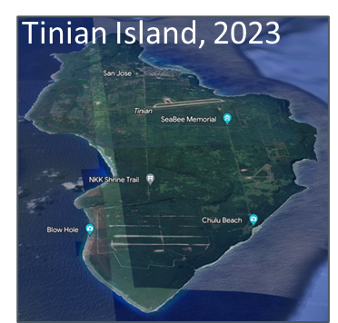
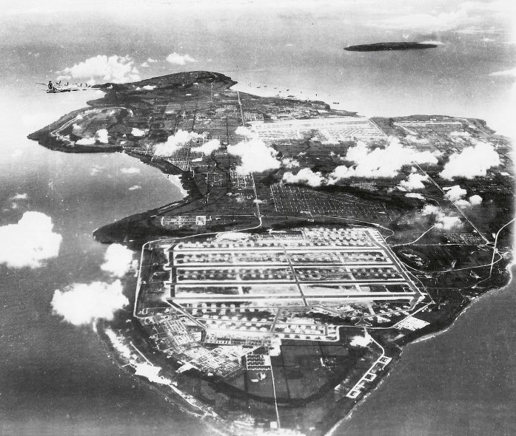
Current Project
Tinian Island, 1945
Five-Year CPFF Task Order to Support RED HORSE paving and construction activities the “Adaptive Rehabilitation of North Field”
630,000+ Tons of Asphalt over Period of Performance
Batch Plant, Support Equipment, Aggregate, Bitumen, Logistics
Integrated with 513 ERHS Team (Site Clearance & Paving Ops)
3

Slide 4
Points of Contact
AFCAP (Air Force Contract Augmentation Program) - AFCEC
For general questions or non-urgent AFCAP assistance, please fill out the AFCAP assistance form (CAC Enabled Users)
https://usaf.dps.mil/teams/10758/CXAE/Lists/AFCAP%20Assistance%20Library/NewForm.aspx?Source=https%3a//usaf.dps.mil/teams/10758/CXAE/Lists/AFCAP%2520Assistance%2520Library/My%2520View.aspx&RootFolder=
For emergencies or any urgent needs, contact the AFCAP Branch Program Managers (Bill Valenti, Dana Patterson, Bryan Opperman, or Sam Schmidt) at DSN: 312-5AFCAP5 (DSN: 312.523.2275) or
COM: (850) 283-2275.
FLUOR:
Rick Sloop, Expeditionary and Logistics Portfolio Manager
501.319.5204/Rick.Sloop@Fluorgov.com
4

Slide 5
Challenges
Local Governance – communication, processes, requirements
Environmental and Biosecurity Requirements
Unexploded Ordnance
Treaties in Force – VISA, Business Registrations, Taxes, Vehicle Registration, Criminal Jurisdiction, etc.
Permitting
Access –
  seaport/airport limitations
  Transportation – US Flag vessels - availability and capability
Operating Environment –
  Weather impacts – rain, jungle growth, humidity, rust/corrosion
  Road networks
  Austere – Time, distance, and availability of materials, work force, support requirements, etc.
5

