Slide 1
Global Contingency Services Multiple Award Contract III (GSMAC III), Contract N6274224D3502
Overview
05-16-2025

Slide 2
Contract Overview
GCSMAC III
NAVFAC, Pacific multiple award contract for the award of Indefinite Delivery/Indefinite Quantity (IDIQ) contracts providing the capability of issuing Cost-Plus-Award-Fee (CPAF) and Firm-Fixed Price (FFP) task orders. $2B Ceiling, PoP: April 2024 – September 2032.
6 Awardees: AECOM-ASO JV, Fluor, Amentum, IAP-ECC, KBR, V2X
Purpose: Provide short-term contingency facility support services in support of natural disasters, humanitarian efforts, the full range of military actions and will also represent a temporary solution to interruptions in other long-term services contracts for similar services (e.g., incumbent contractor’s non-performance, default, or bankruptcy) or potential breaks in service between awards of successive contracts (e.g., for a protest or while a long-term contract is being developed).

Slide 3
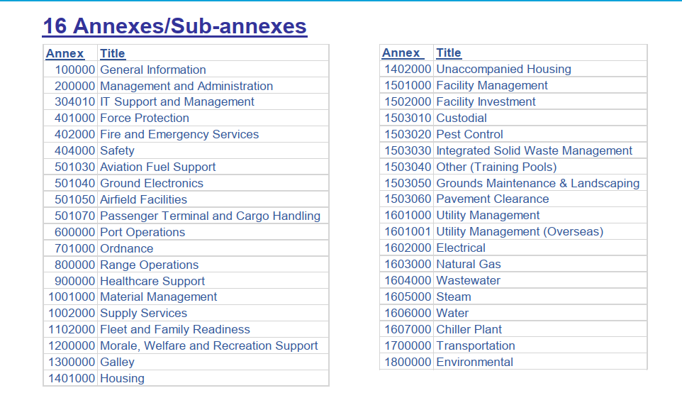
Usage Examples
GCSMAC III
Scope includes a wide range of potential services:
  Command and Staff, Public Safety, Air and Port Operations, Ordnance, Range Operations, Health Care Support, Supply, Personnel Support, MW&R Support, Galley, Housing, Facilities Support Utilities, Base Support Vehicles and Equipment, and Environmental.
  AECOM: Utility Security/Mission Assurance Assessment
  IAP-ESS: Romania BOS
  Red Hill Water Treatment
  KBR: BOS at Missile Site in Poland, OAW Support
  Fluor: Expeditionary Staging Area, Parris Island
GCSMAC III:
  V2X: GITMO BOS support to Operation Southern Guard

Slide 4
Application in a Contested Environment
GCSMAC III
Wartime Acquisition Response Plan (WARP) Pacific Sentry 25-2 Contractor Exercise
  Simulate a real-world wartime scenario in the United States Indo-Pacific Command (USINDOPACOM) Area of Responsibility (AOR) to assess the capabilities of Contractor support to immediately provide facilities support services and integrate with military operational forces. Designed to test and evaluate NAVFAC Pacific, military operational forces and Contractor support. Emphasize the acquisition processes to provide rapid procurement of services for the deployment and sustainment of forces.

Slide 5
How to Access
GCSMAC III
NAVFAC Pacific
  Matt Moses – Contracting Officer
    matthew.s.moses.civ@us.navy.mil
  Tiffany Tamate – Contract Specialist
    tiffany.k.tamate.civ@us.navy.mil

